Slide 1
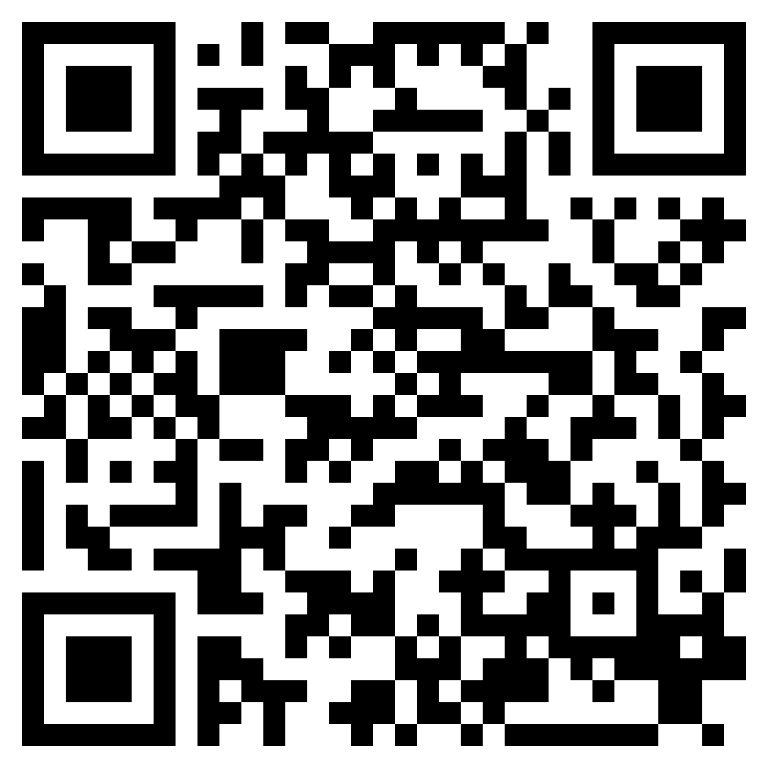

Slide 2
Acts 1:1–3 (ESV)
¹ In the first book, O Theophilus, I have dealt with all that Jesus began to do and teach, ² until the day when he was taken up, after he had given commands through the Holy Spirit to the apostles whom he had chosen. ³ He presented himself alive to them after his suffering by many proofs, appearing to them during forty days and speaking about the kingdom of God.

Slide 3
Luke 1:1–4 (ESV)
¹ Inasmuch as many have undertaken to compile a narrative of the things that have been accomplished among us, ² just as those who from the beginning were eyewitnesses and ministers of the word have delivered them to us, ³ it seemed good to me also, having followed all things closely for some time past, to write an orderly account for you, most excellent Theophilus, ⁴ that you may have certainty concerning the things you have been taught.

Slide 4
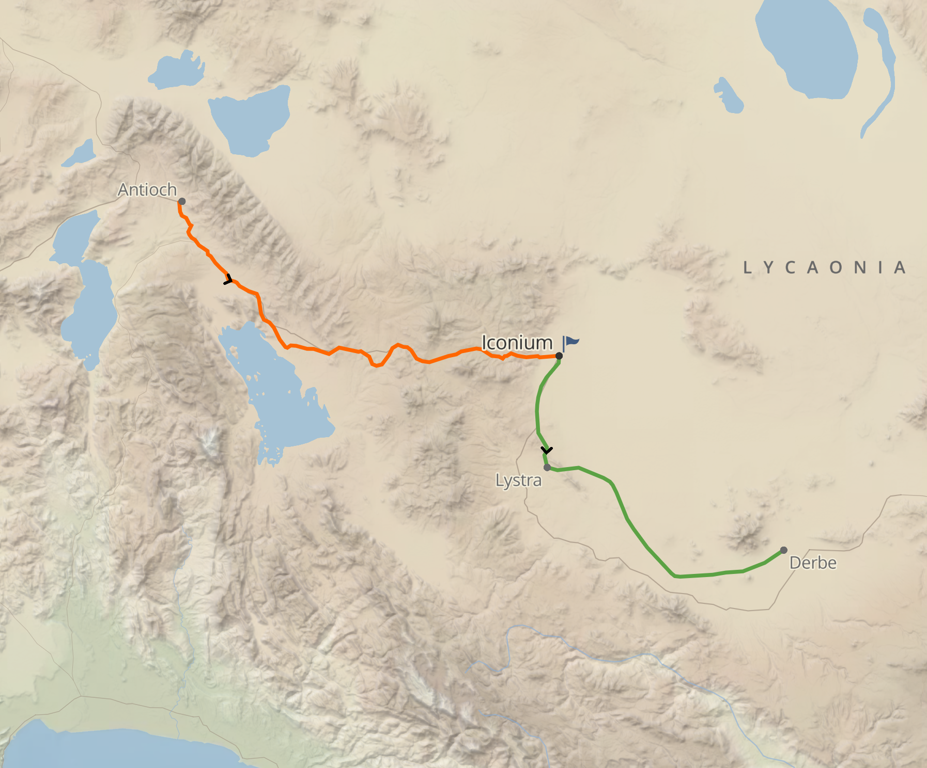

Slide 5
“The boundaries mentioned are true to the period in which the action lies: they are not placed through the mistaken application by a later author of ancient statements to a time when they ceased to be pertinent: they are based on information given by an eye-witness, a person who had been engaged in the action described. The reader, if he reads the narrative rightly, can see with the eyes and hear with the ears of a man who was there and witnessed all that happened.”
- Sir. William Ramsay

Slide 6
“There is a certain presumption that a writer who proves to be exact and correct in one point will show the same qualities in other matters. No writer is correct by mere chance, or accurate sporadically. He is accurate by virtue of a certain habit of mind. Some men are accurate by nature; some are by nature loose and inaccurate.”
- Sir. William Ramsay

Slide 7
Acts 1:1–3 (ESV)
¹ In the first book, O Theophilus, I have dealt with all that Jesus began to do and teach, ² until the day when he was taken up, after he had given commands through the Holy Spirit to the apostles whom he had chosen. ³ He presented himself alive to them after his suffering by many proofs, appearing to them during forty days and speaking about the kingdom of God.
LUKE’S PURPOSE

Slide 8
Acts 28:30–31 (ESV)
³⁰ He lived there two whole years at his own expense, and welcomed all who came to him, ³¹ proclaiming the kingdom of God and teaching about the Lord Jesus Christ with all boldness and without hindrance.
LUKE’S PURPOSE

Slide 9
Psalm 103:19 (ESV)
¹⁹ The Lord has established his throne in the heavens, and his kingdom rules over all.
THE KINGDOM OF GOD

Slide 10
Exodus 19:5–6 (ESV)
5 Now therefore, if you will indeed obey my voice and keep my covenant, you shall be my treasured possession among all peoples, for all the earth is mine; 6 and you shall be to me a kingdom of priests and a holy nation.’ These are the words that you shall speak to the people of Israel.”
THE KINGDOM OF GOD

Slide 11
Mark 1:14–15 (ESV)
¹⁴ Now after John was arrested, Jesus came into Galilee, proclaiming the gospel of God, ¹⁵ and saying, “The time is fulfilled, and the kingdom of God is at hand; repent and believe in the gospel.”
THE KINGDOM OF GOD

Slide 12
Mark 9:1 (ESV)
¹ And he said to them, “Truly, I say to you, there are some standing here who will not taste death until they see the kingdom of God after it has come with power.”
THE KINGDOM OF GOD

Slide 13
Acts 1:1–3 (ESV)
¹ In the first book, O Theophilus, I have dealt with all that Jesus began to do and teach, ² until the day when he was taken up, after he had given commands through the Holy Spirit to the apostles whom he had chosen. ³ He presented himself alive to them after his suffering by many proofs, appearing to them during forty days and speaking about the kingdom of God.

Slide 14
Acts 1:8 (ESV)
⁸ But you will receive power when the Holy Spirit has come upon you, and you will be my witnesses in Jerusalem and in all Judea and Samaria, and to the end of the earth.”

Slide 15
Acts 1:8 (ESV)
⁸ But you will receive power when the Holy Spirit has come upon you, and you will be my witnesses in Jerusalem and in all Judea and Samaria, and to the end of the earth.”

