Slide 1
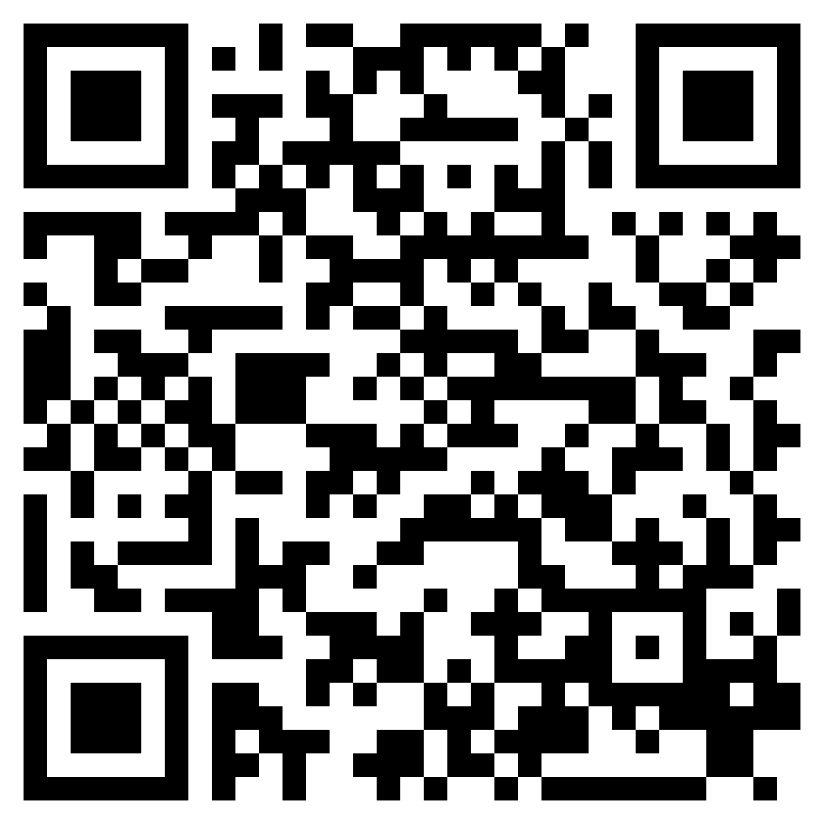
DISCERNING THE WILL OF THE KING
ACTS 15

Slide 2
“But some men came down from Judea and were teaching the brothers, “Unless you are circumcised according to the custom of Moses, you cannot be saved.”” (Acts 15:1, ESV)

Slide 3
Genesis 17:10, 13-14 (ESV)
¹⁰ This is my covenant, which you shall keep, between me and you and your offspring after you: Every male among you shall be circumcised… ¹³ both he who is born in your house and he who is bought with your money, shall surely be circumcised. So shall my covenant be in your flesh an everlasting covenant. ¹⁴ Any uncircumcised male who is not circumcised in the flesh of his foreskin shall be cut off from his people; he has broken my covenant.”

Slide 4
Matthew 5:17 (ESV)
¹⁷ “Do not think that I have come to abolish the Law or the Prophets; I have not come to abolish them but to fulfill them.

Slide 5
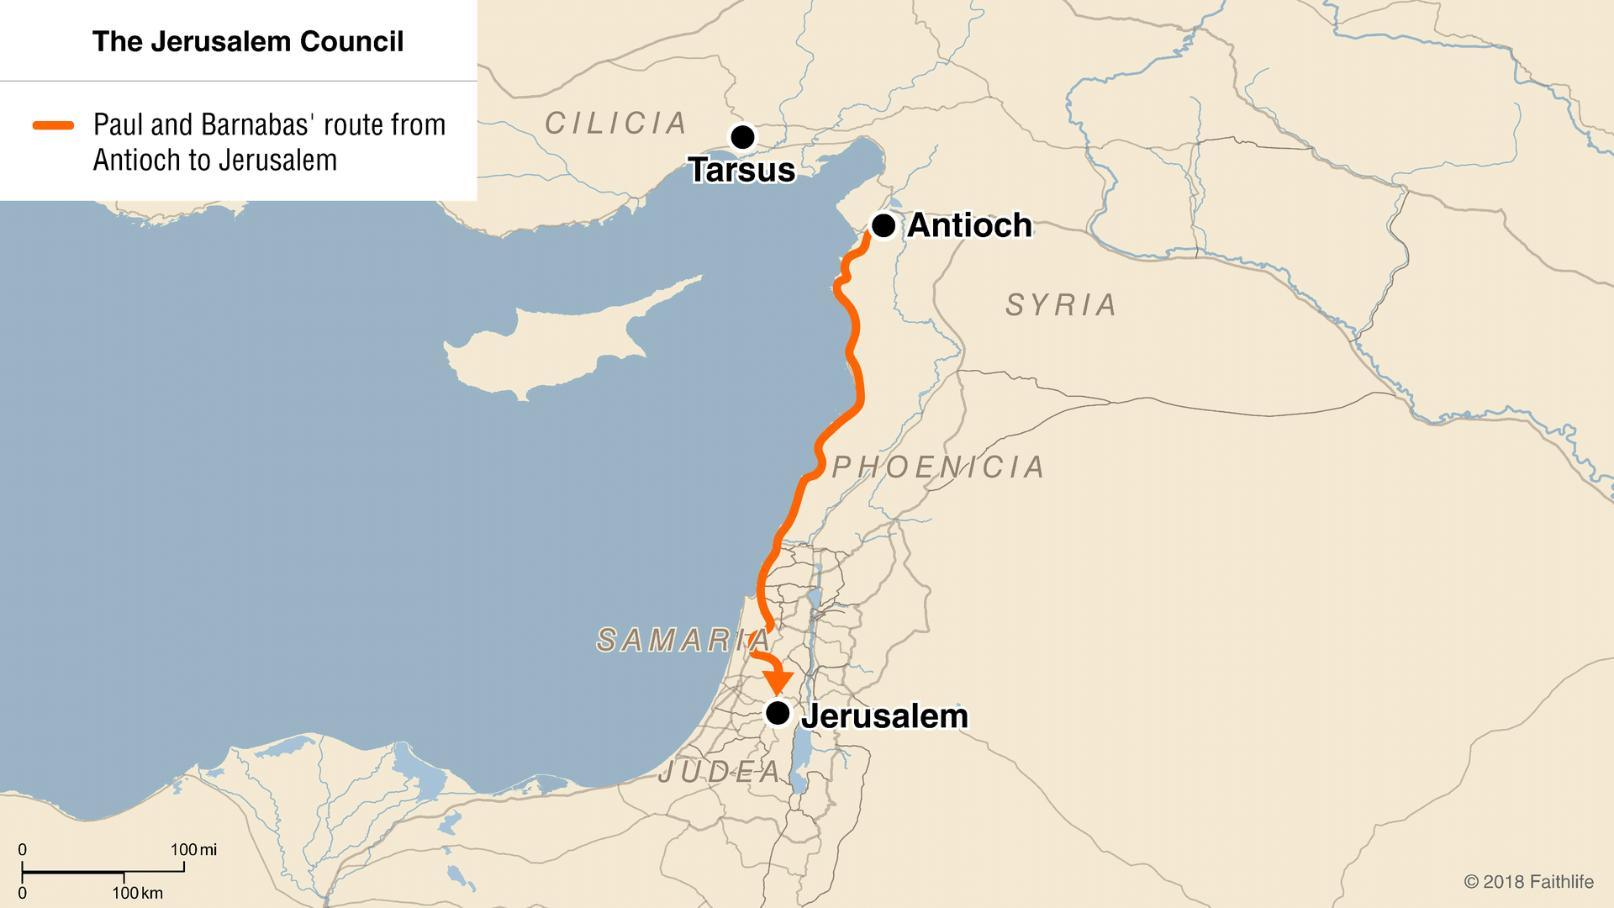

Slide 7
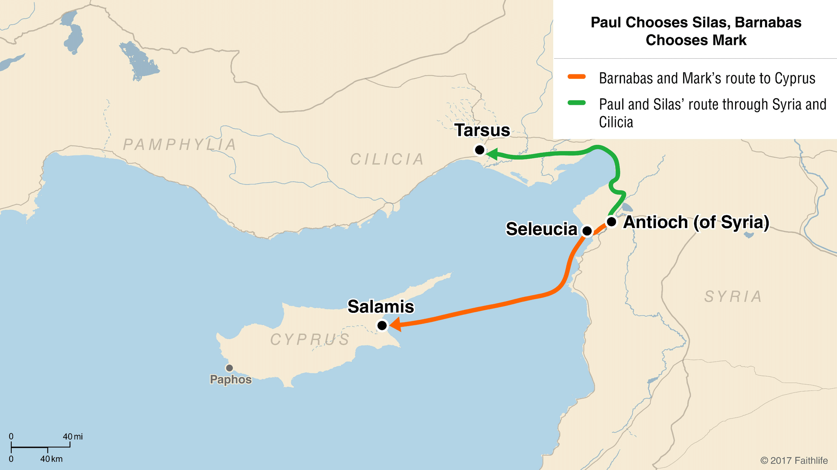

Slide 8
DISCERNING THE WILL OF THE KING
ACTS 15

