Slide 1
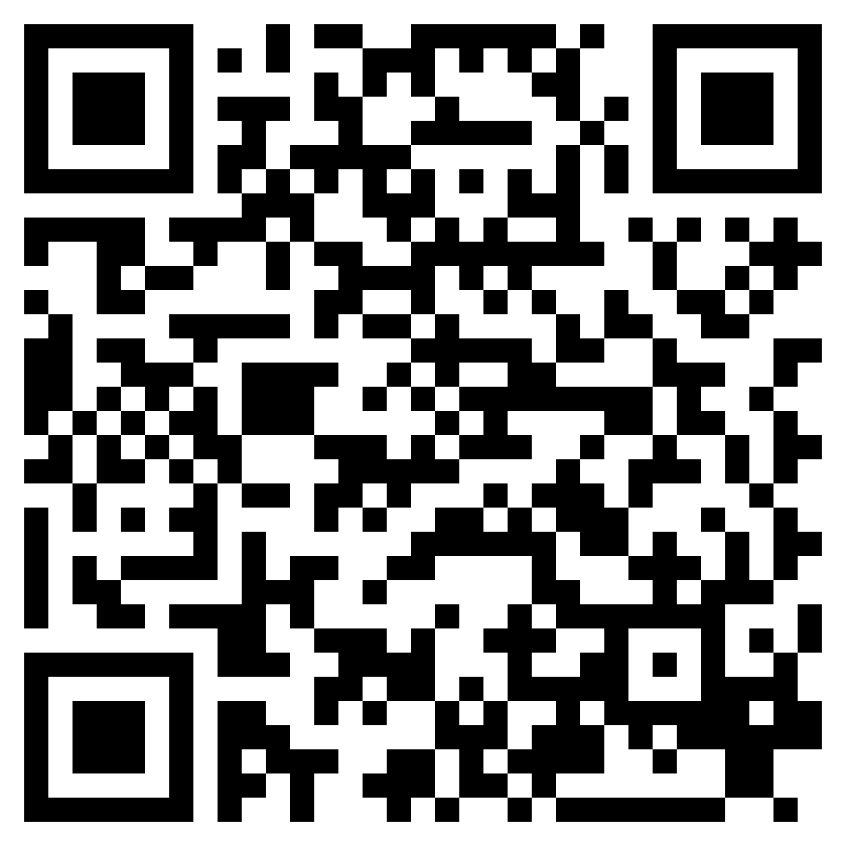
THE LORD’S CHOSEN INSTRUMENT
ACTS 9.1-31

Slide 2
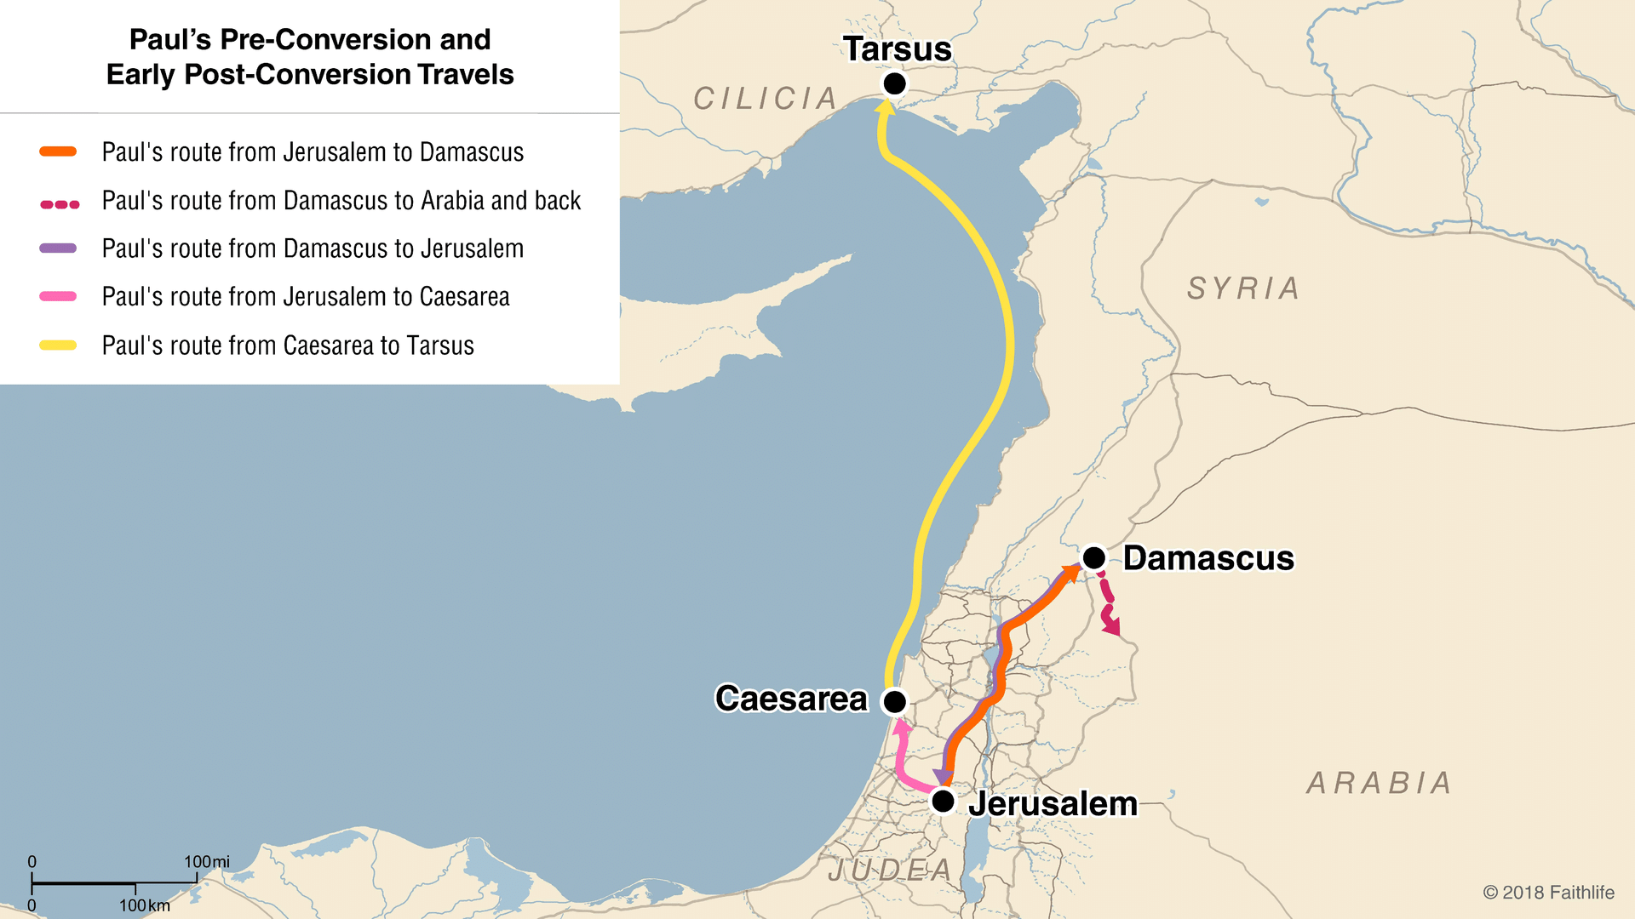

Slide 3
THE LORD’S CHOSEN INSTRUMENT
ACTS 9.1-31

