Slide 1
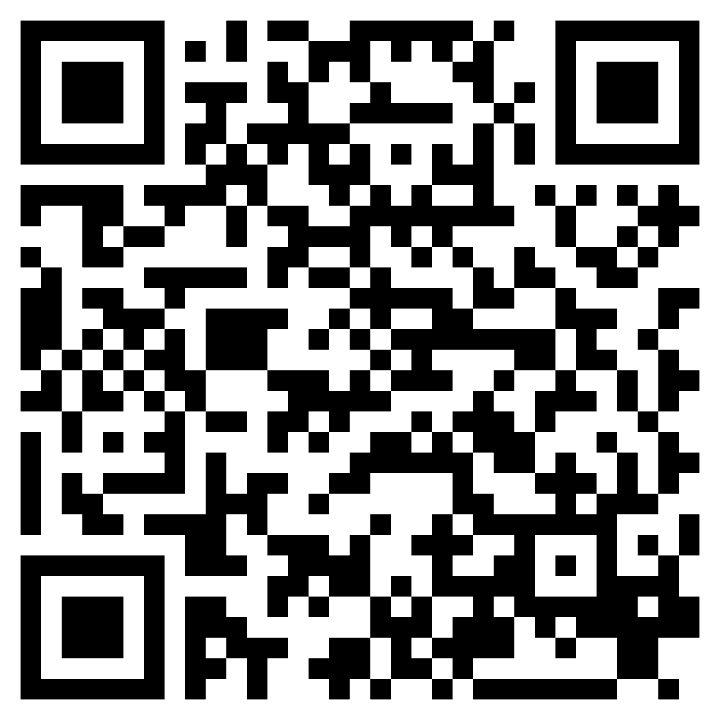
THROUGH MANY TRIBULATIONS
ACTS 14

Slide 2
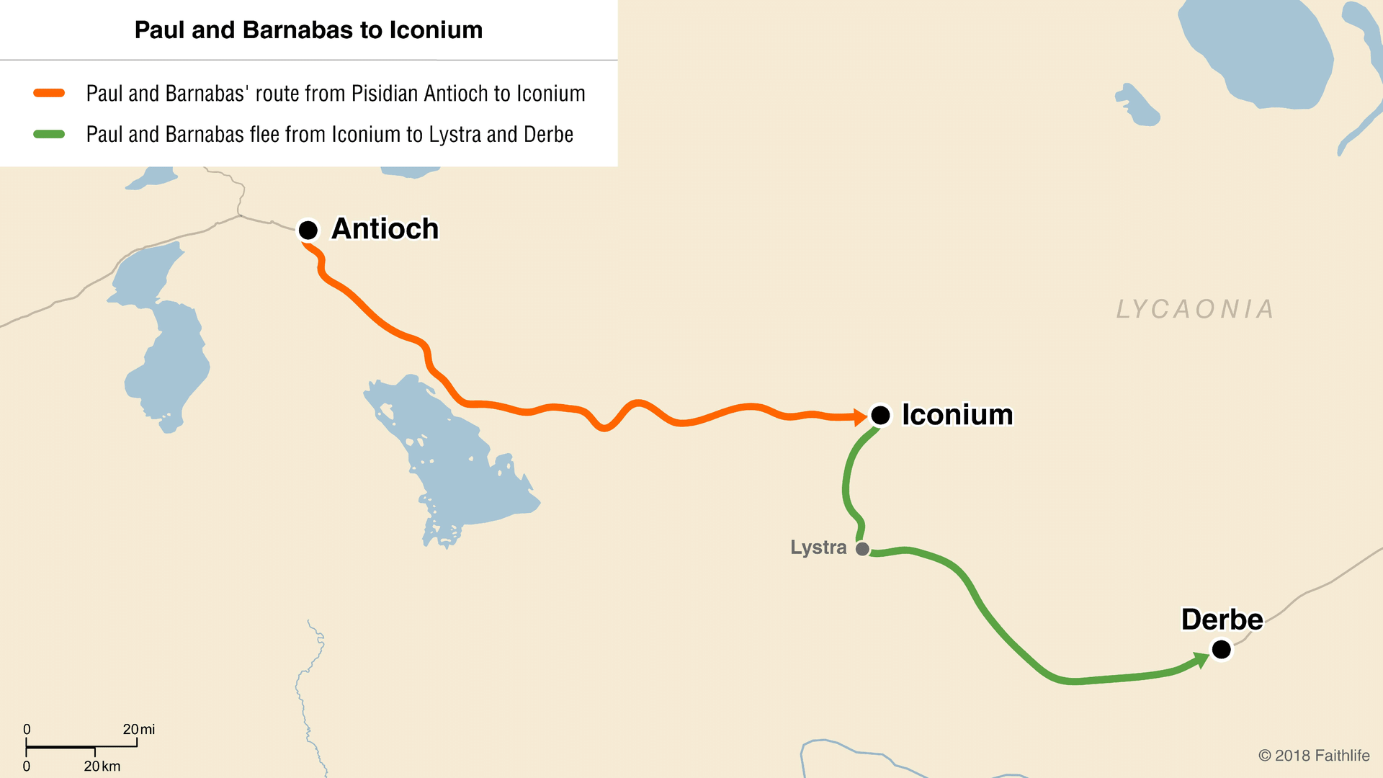

Slide 3
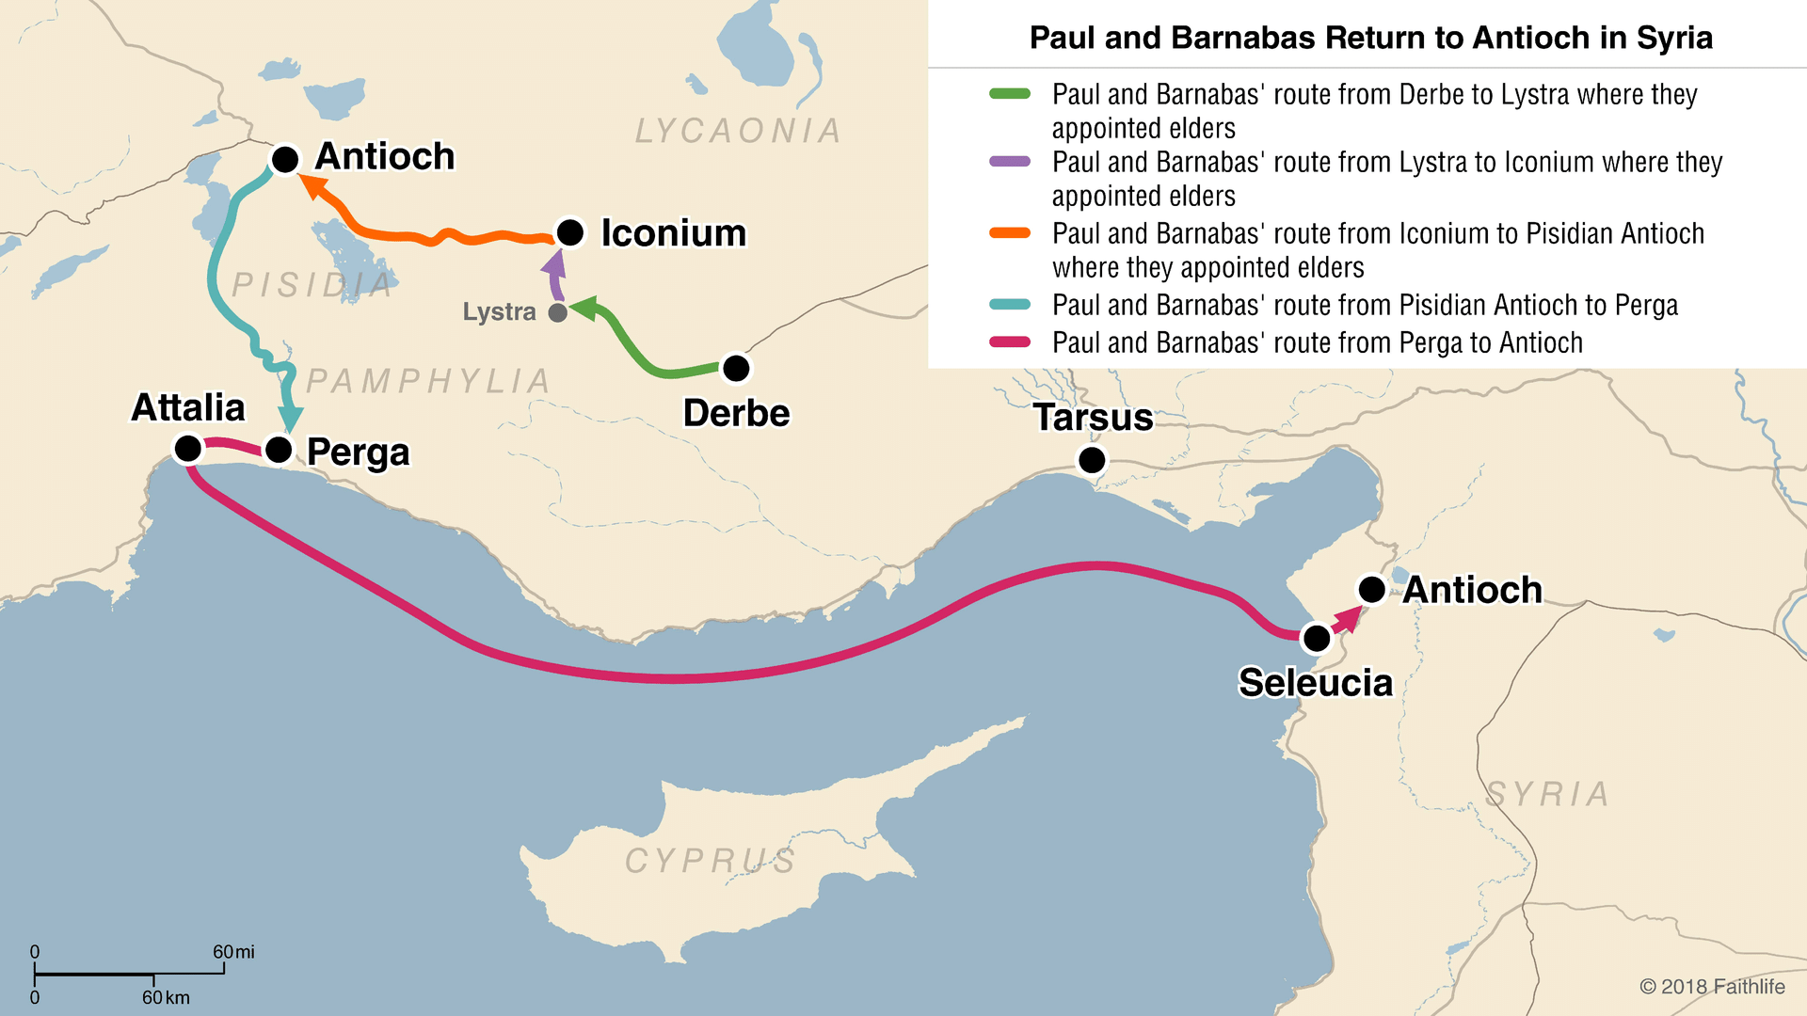

Slide 4
THROUGH MANY TRIBULATIONS
ACTS 14

