Slide 1
LEADERSHIP IN THE KINGDOM
ACTS 20

Slide 2
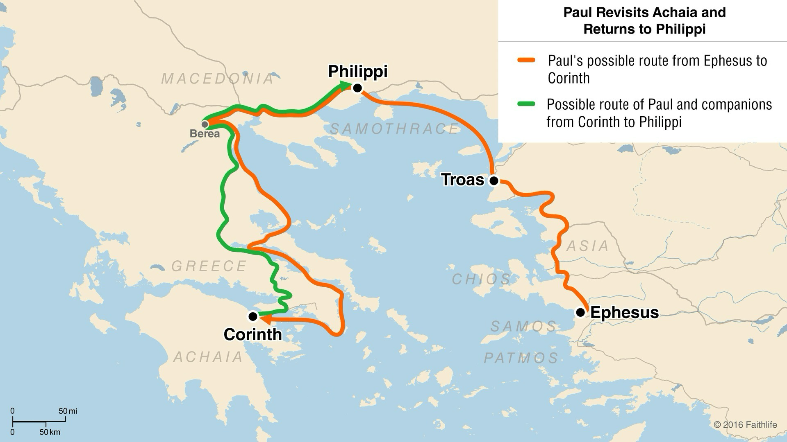

Slide 3
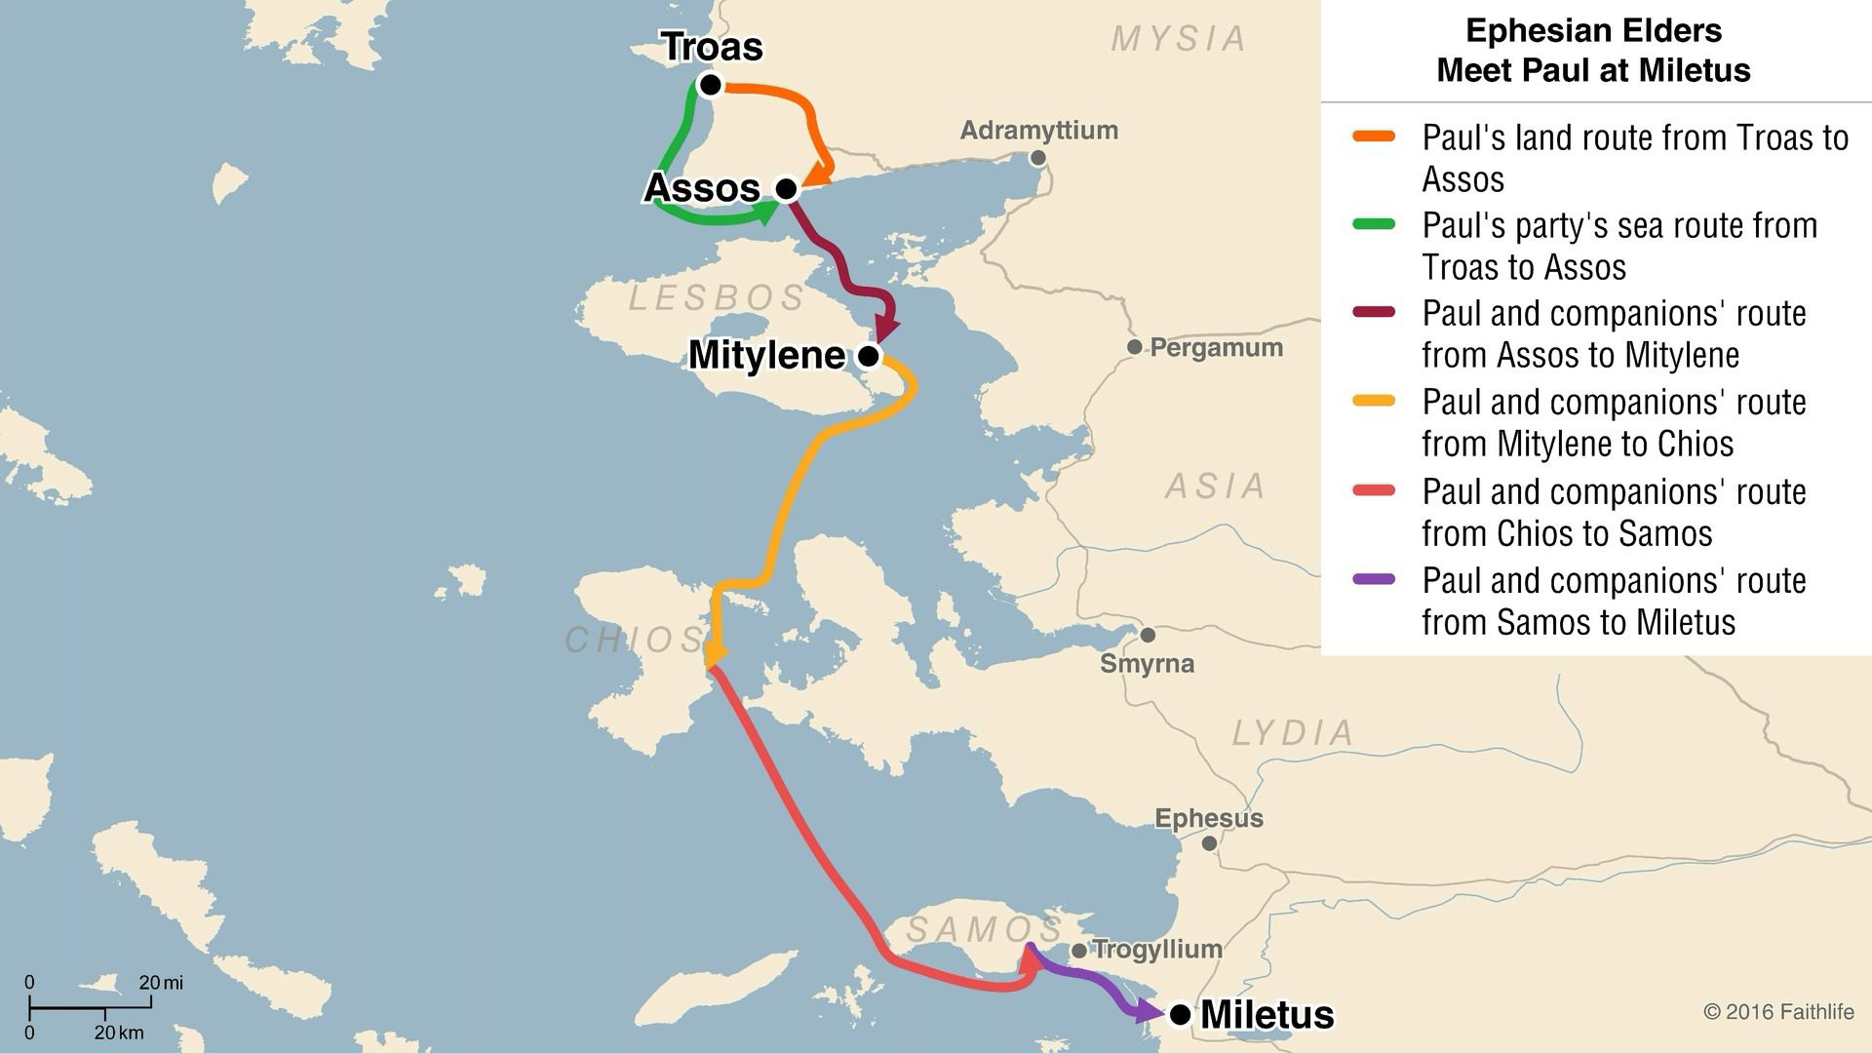

Slide 4
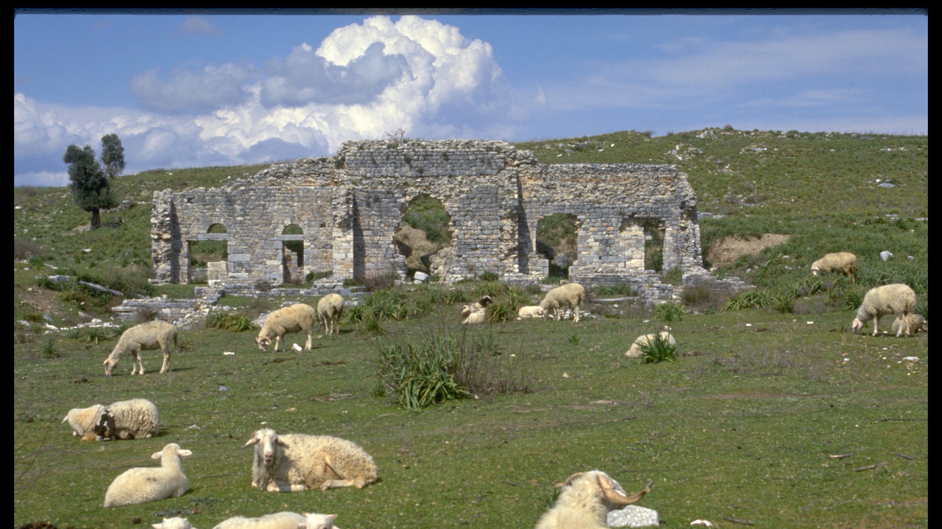

Slide 5
Acts 20:17 (ESV)
¹⁷Now from Miletus he sent to Ephesus and called the elders of the church to come to him.
Acts 20:28 (ESV)
²⁸Pay careful attention to yourselves and to all the flock, in which the Holy Spirit has made you overseers, to care for the church of God, which he obtained with his own blood.

Slide 7
Leading is serving (vs. 19)
Leadership takes an emotional toil (vss. 19,31)
Leadership requires teaching ALL of the Lord’s will (vss. 20,27)
Leadership requires sacrifice (vs. 28)
God is with His leaders (vs. 32)
LEADERSHIP IN THE KINGDOM

Slide 8
LEADERSHIP IN THE KINGDOM
ACTS 20

