Slide 1
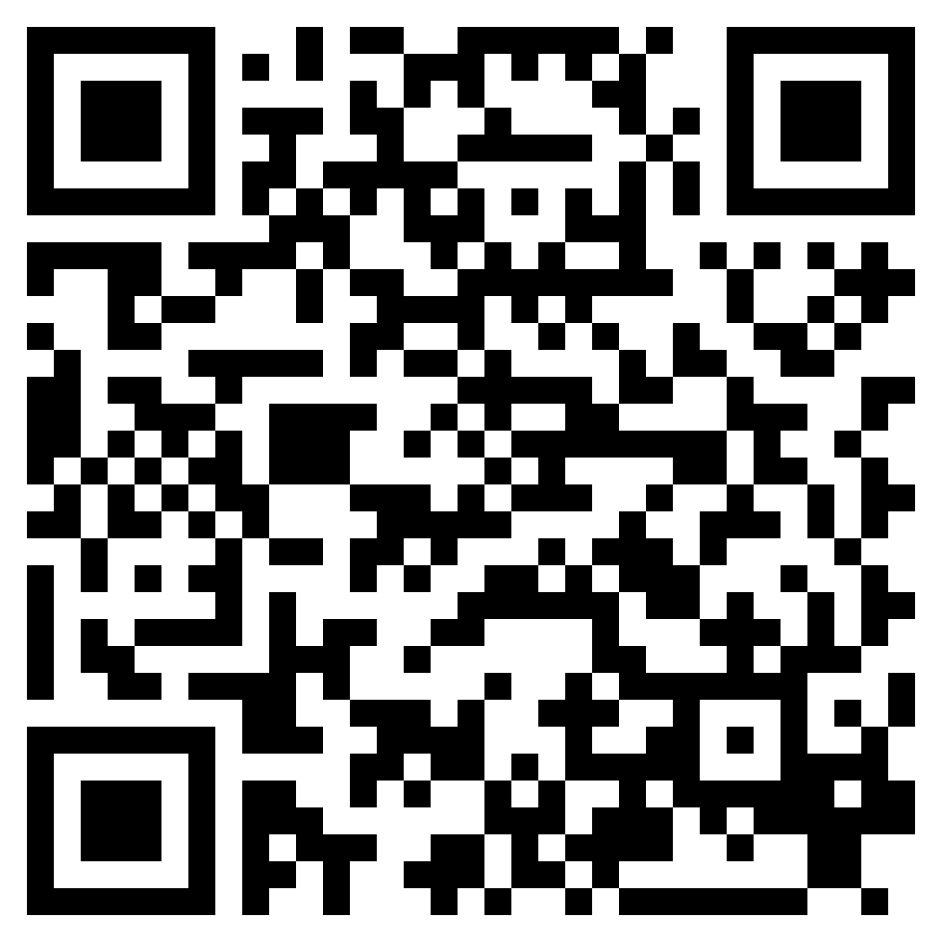
PEACE IN THE KINGDOM
ACTS 21

Slide 2
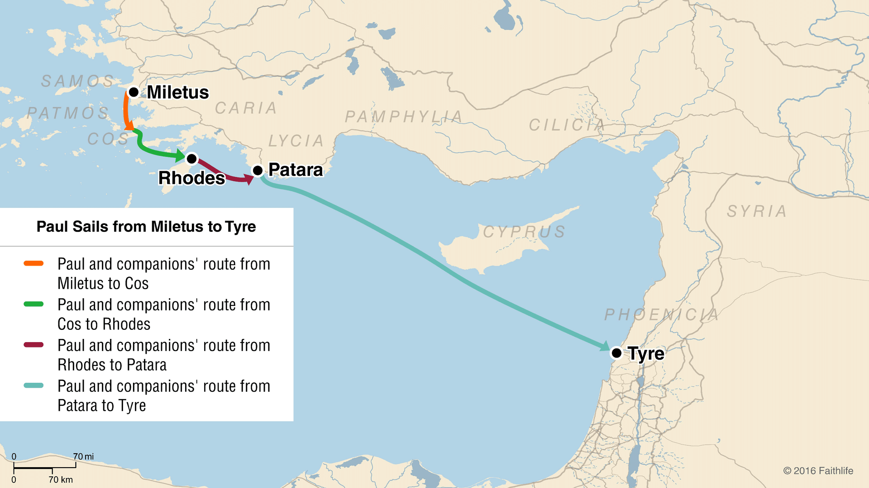

Slide 3
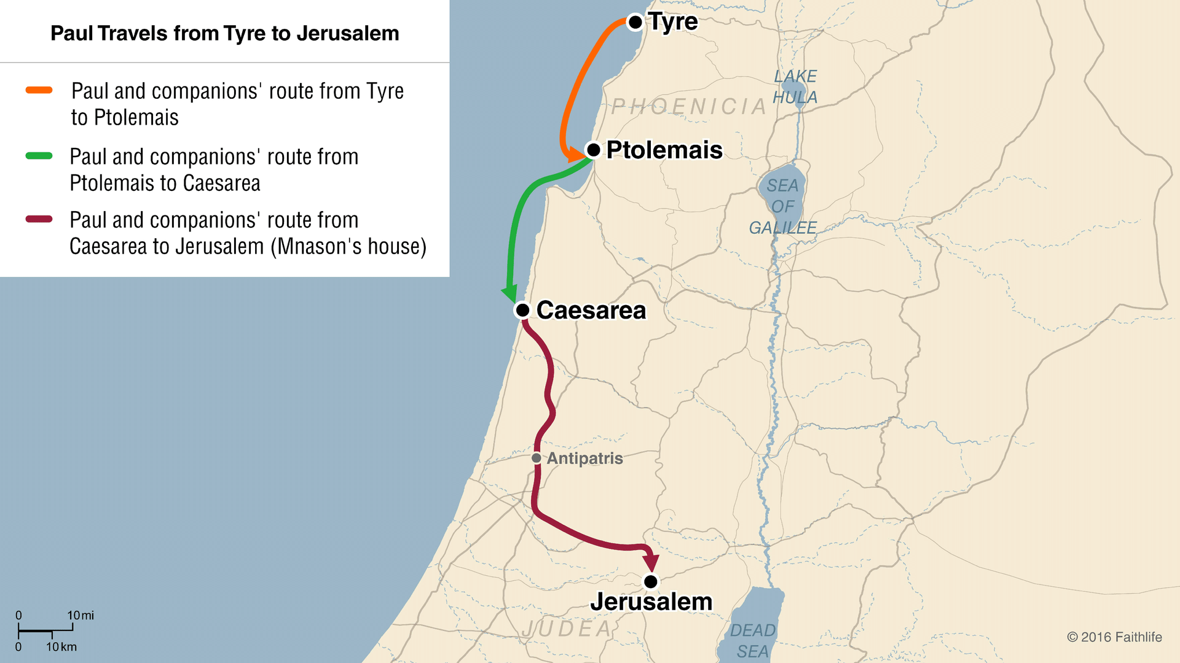

Slide 4
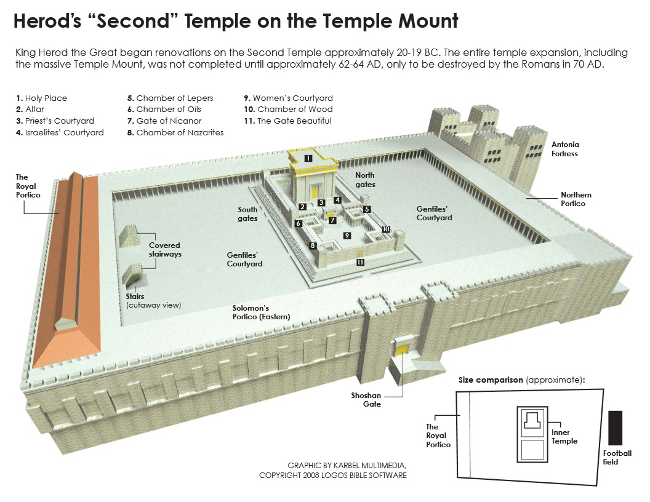

Slide 5
PEACE IN THE KINGDOM
ACTS 21

