Slide 1
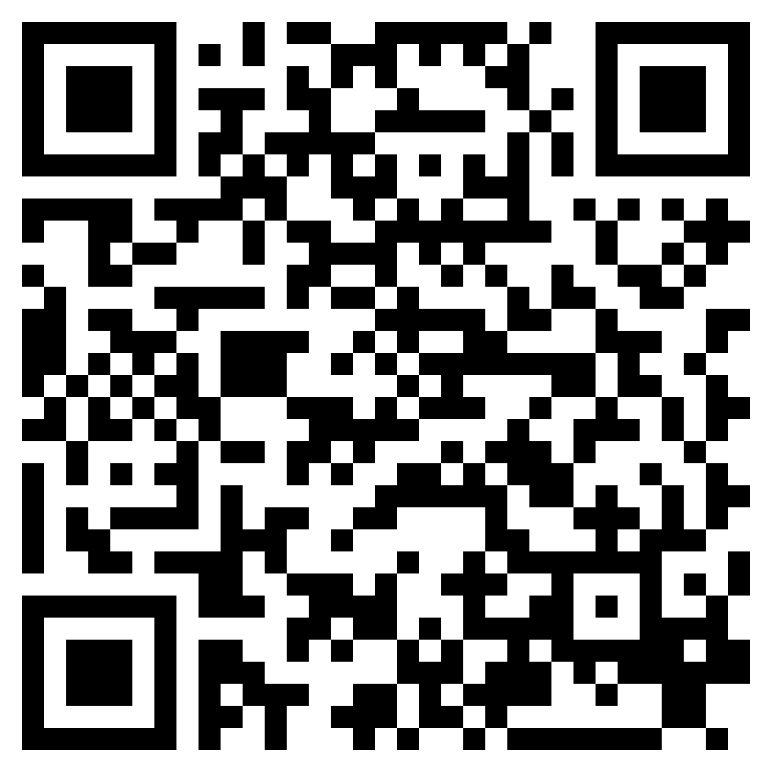
DEFENDING THE KINGDOM, PART 3
ACTS 25-26

Slide 2
“But the Lord said to him, “Go, for he is a chosen instrument of mine to carry my name before the Gentiles and kings and the children of Israel.” (Acts 9:15, ESV)

Slide 3
“The following night the Lord stood by him and said, “Take courage, for as you have testified to the facts about me in Jerusalem, so you must testify also in Rome.”” (Acts 23:11, ESV)

Slide 4
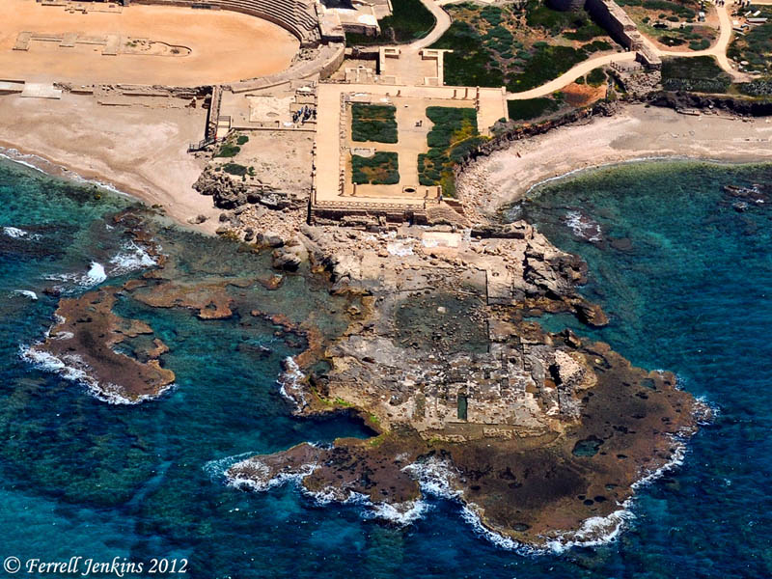
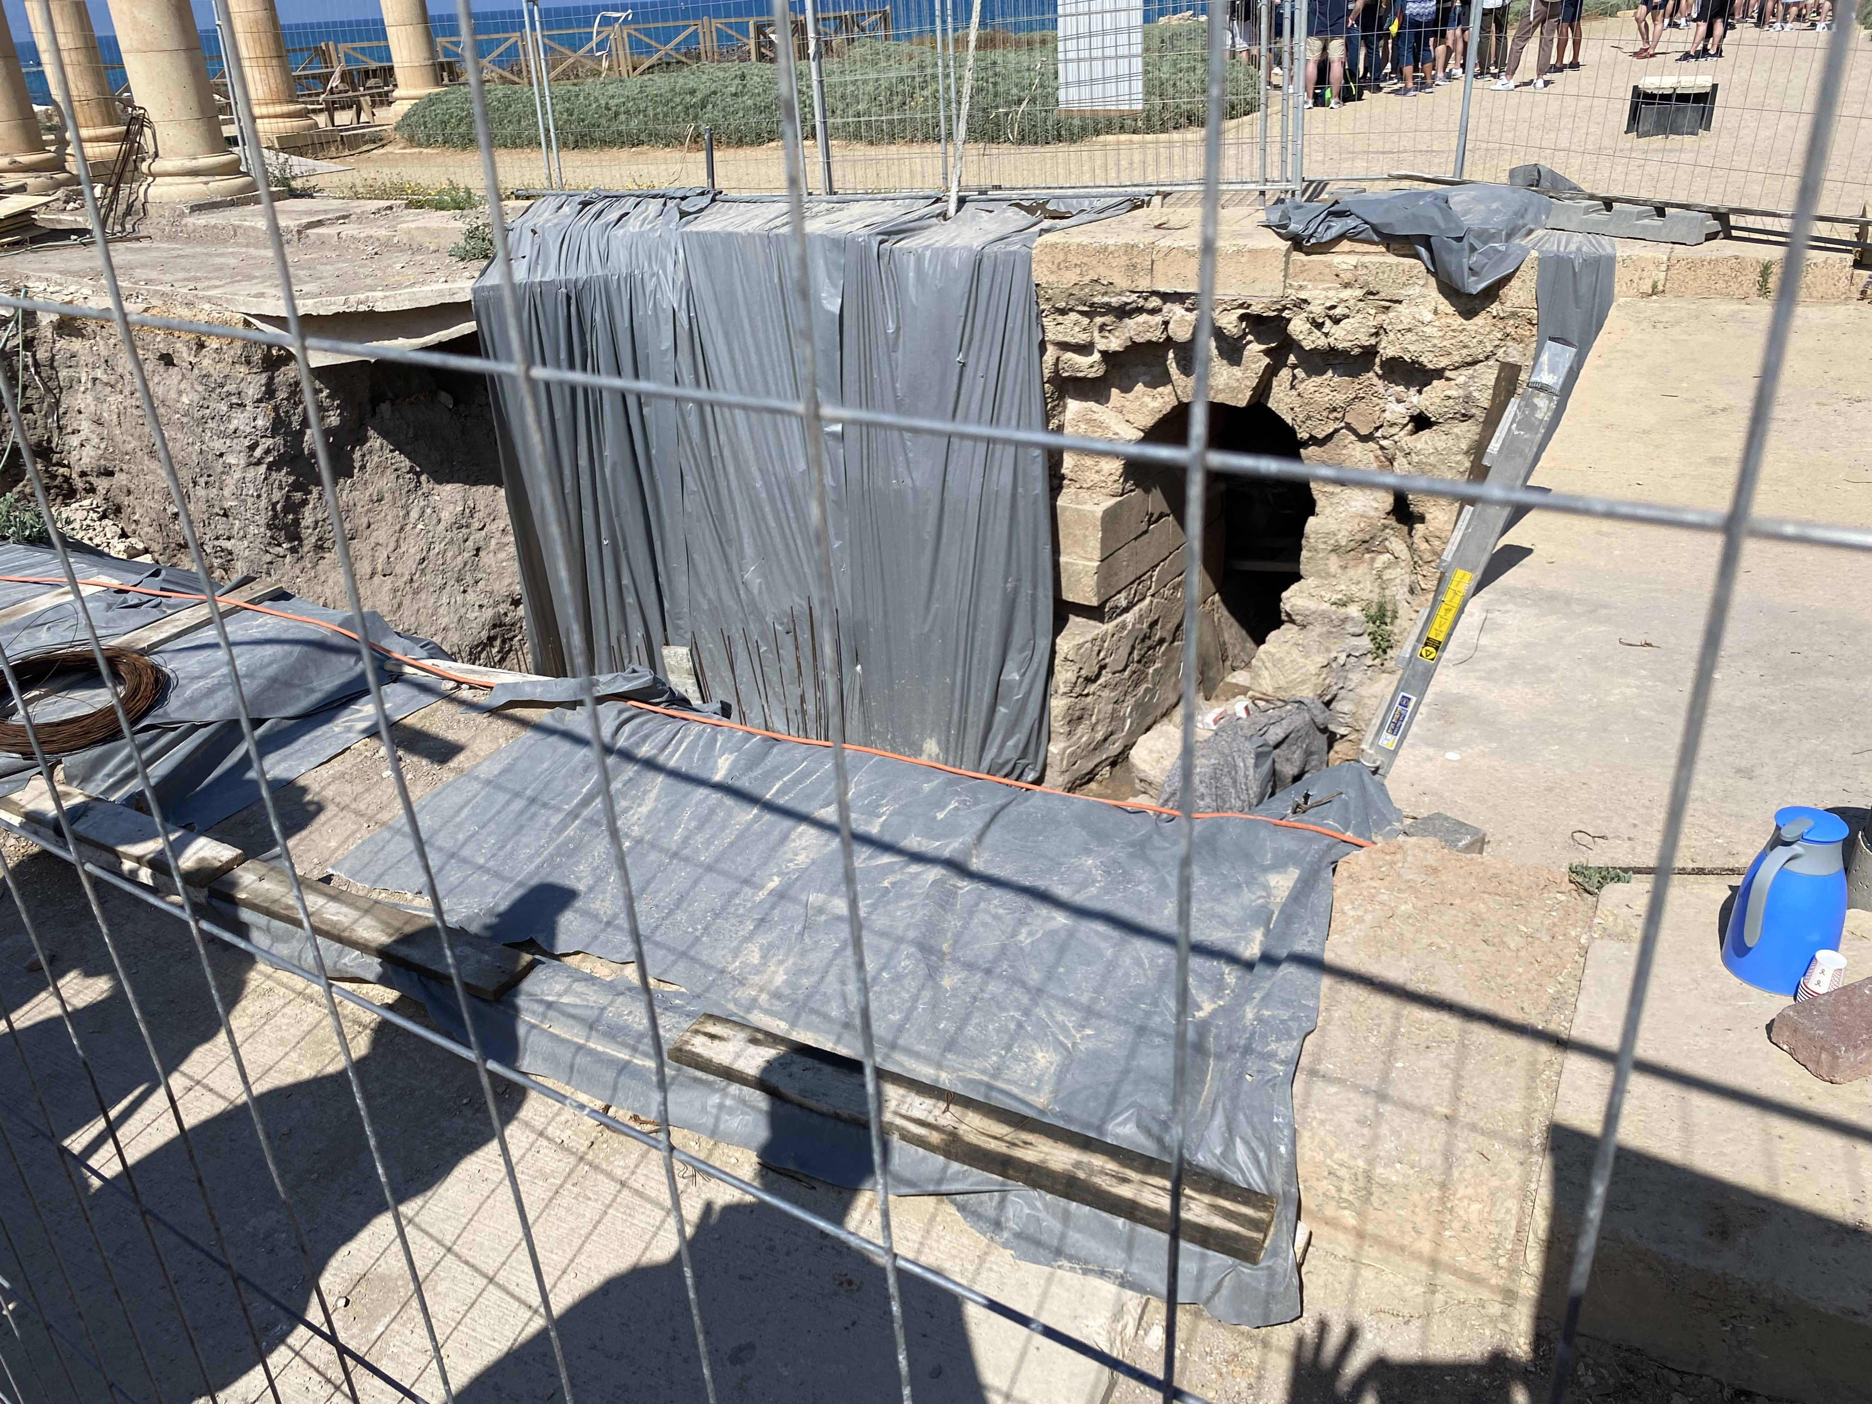

Slide 6
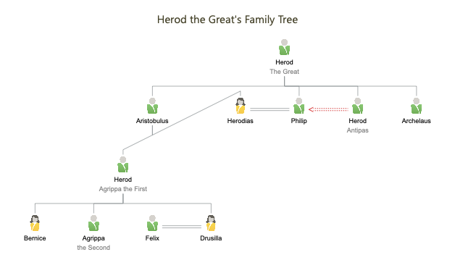

Slide 8
DEFENDING THE KINGDOM, PART 3
ACTS 25-26

