Slide 1
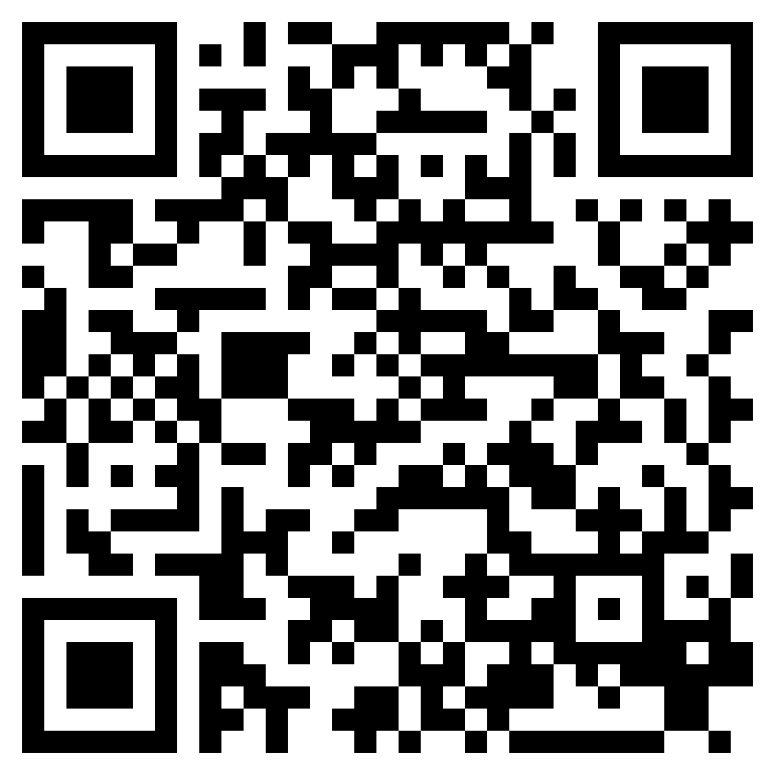
TRIUMPH OVER THE GODS
ACTS 19

Slide 2
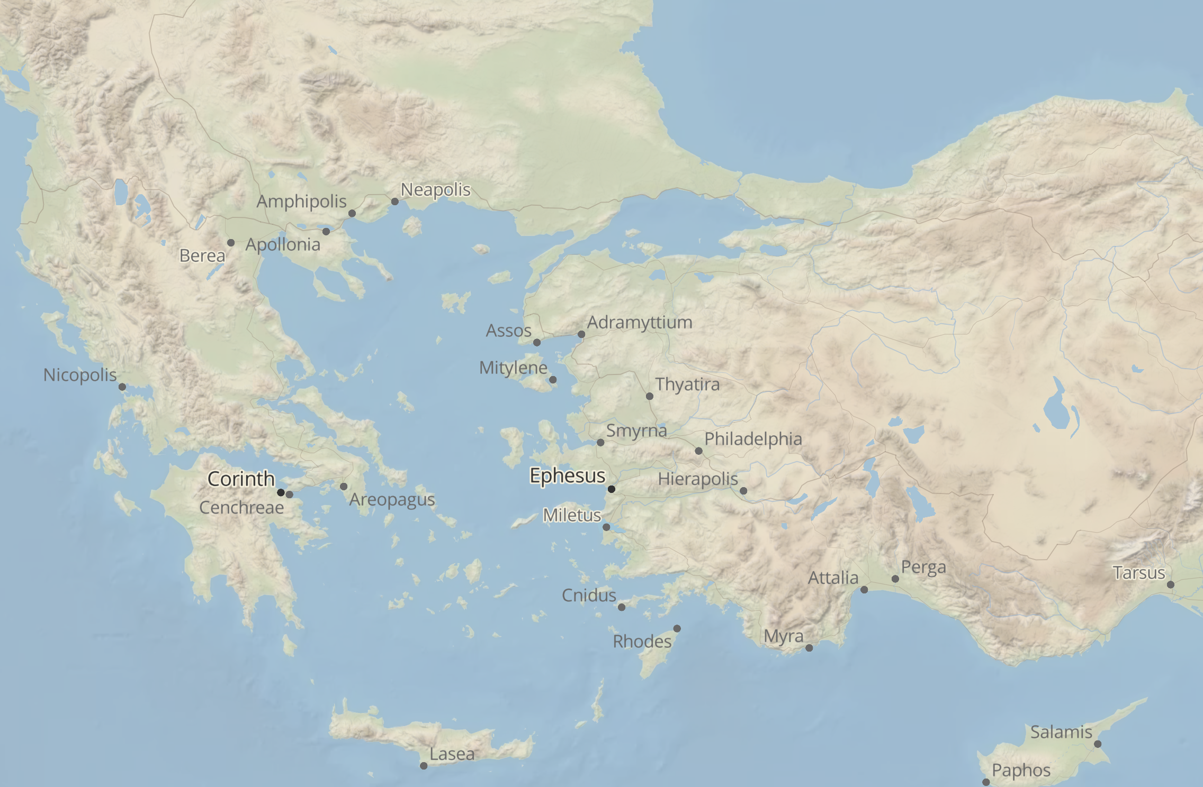

Slide 3
Acts 19:2–3 (ESV)
² And he said to them, “Did you receive the Holy Spirit when you believed?” And they said, “No, we have not even heard that there is a Holy Spirit.” ³ And he said, “Into what then were you baptized?” They said, “Into John’s baptism.”

Slide 4
Acts 19:4–5 (ESV)
⁴ And Paul said, “John baptized with the baptism of repentance, telling the people to believe in the one who was to come after him, that is, Jesus.” ⁵ On hearing this, they were baptized in the name of the Lord Jesus.

Slide 8
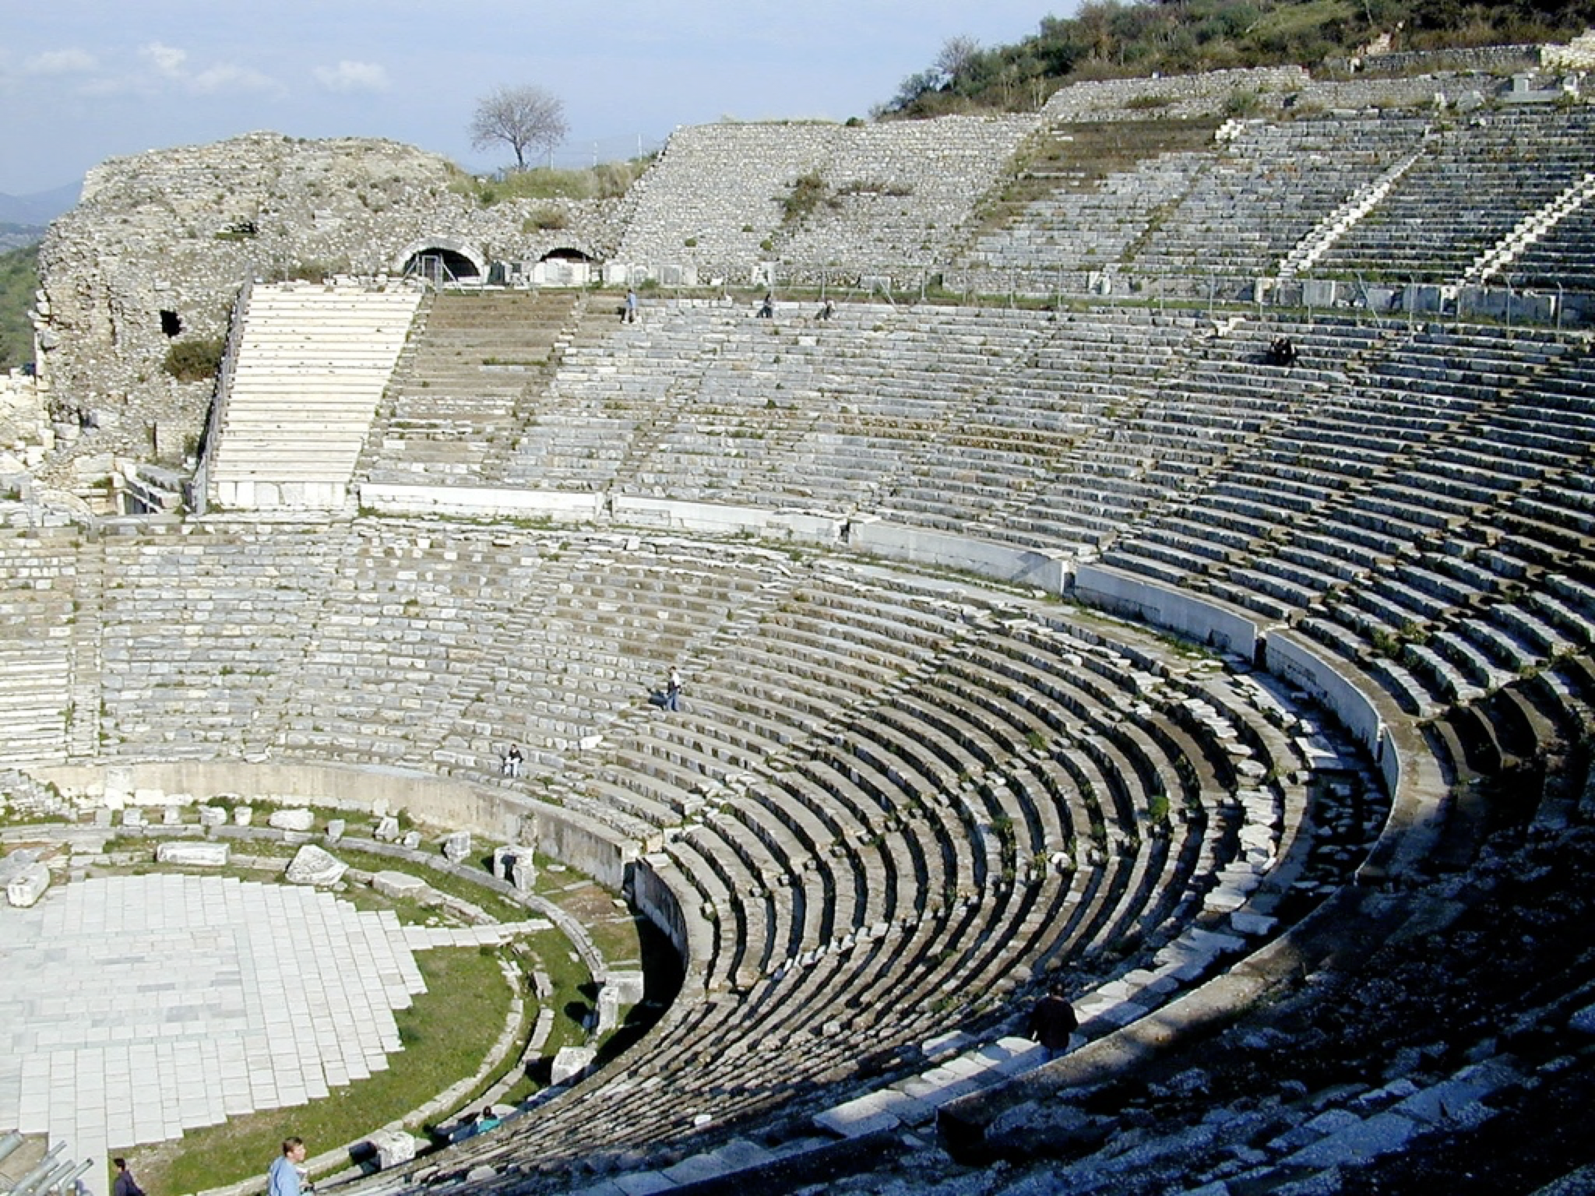
Bibleplaces.com

Slide 9
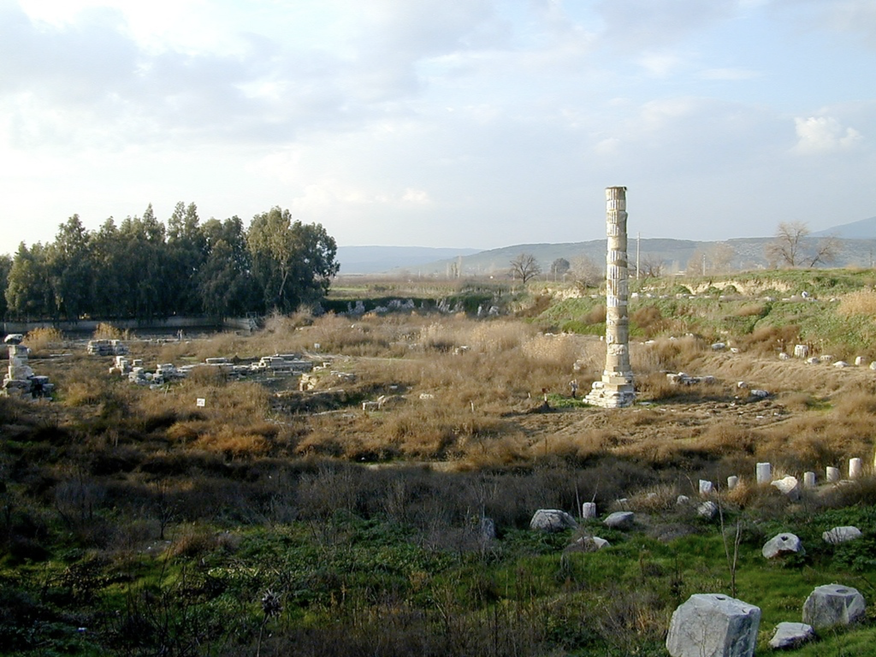
Bibleplaces.com

Slide 10
“So the word of the Lord continued to increase and prevail mightily.” (Acts 19:20, ESV)
Bibleplaces.com

Slide 11
TRIUMPH OVER THE GODS
ACTS 19

