Slide 1
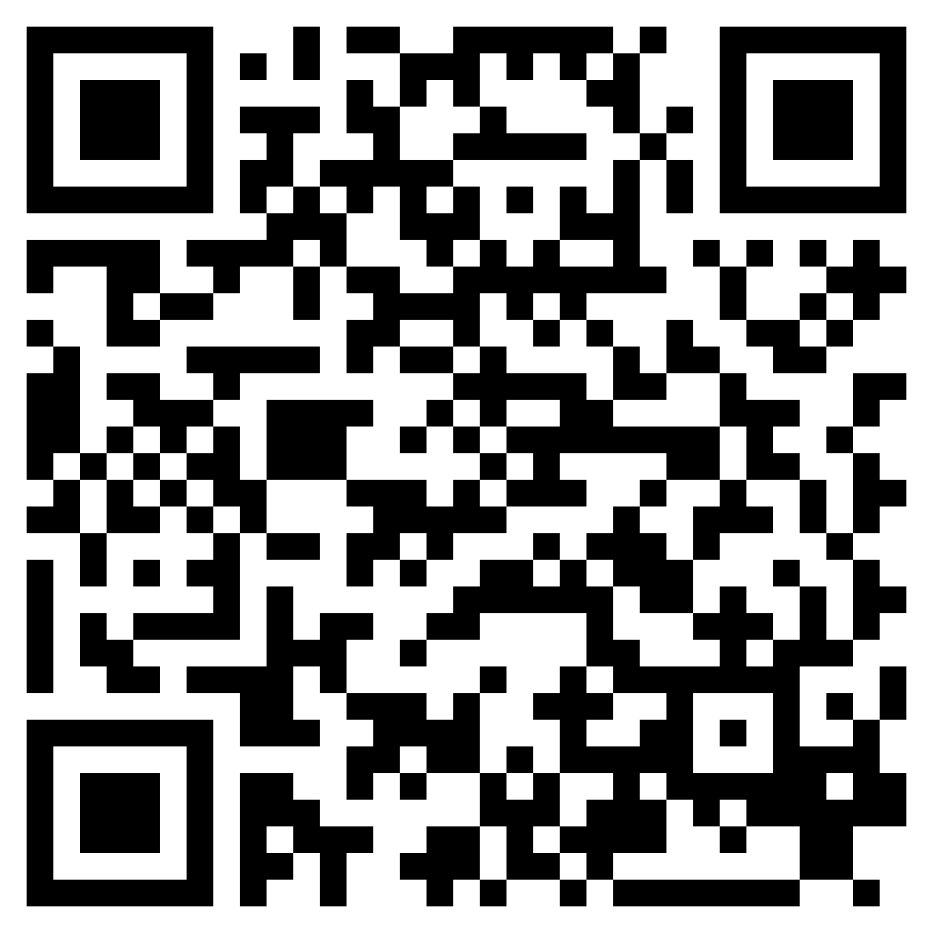
“I HAVE MANY IN THIS CITY”
ACTS 18

Slide 2
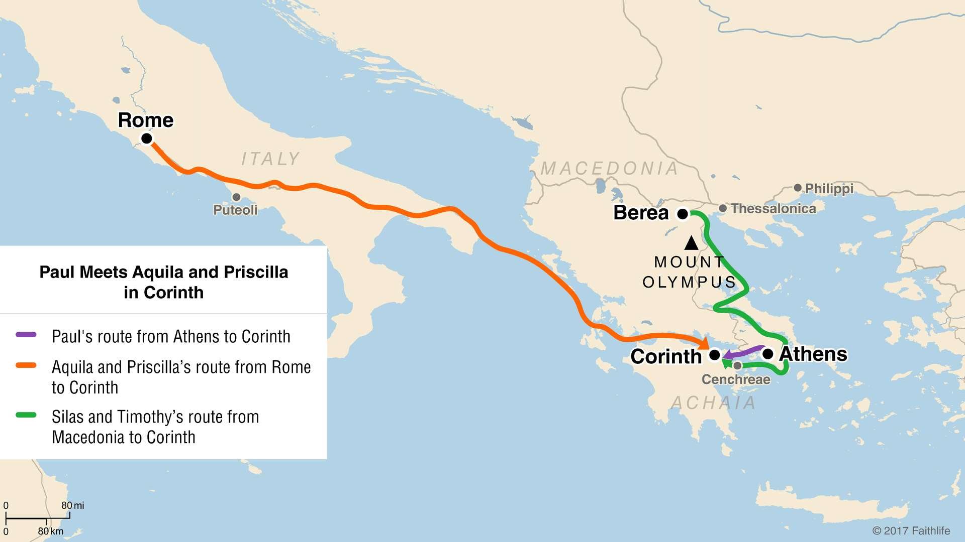

Slide 3
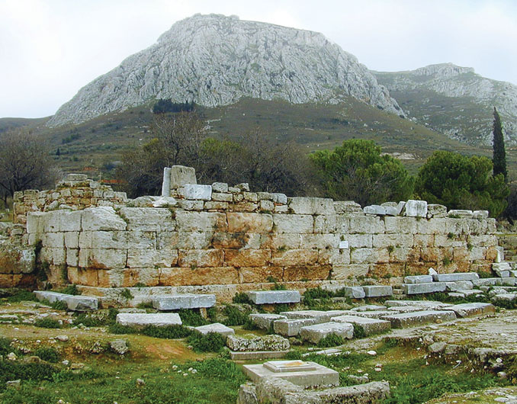

Slide 4
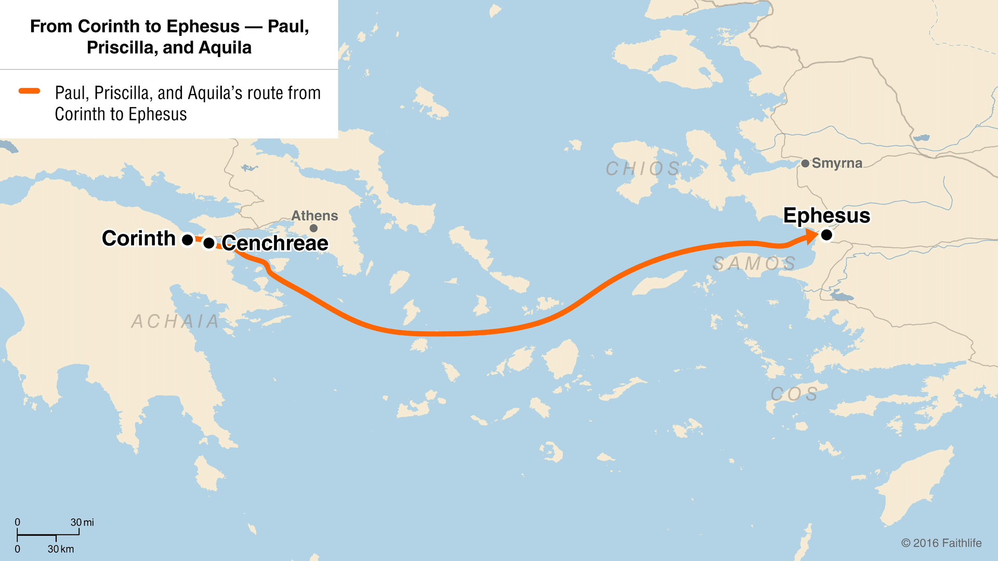

Slide 5
“I HAVE MANY IN THIS CITY”
ACTS 18

