Slide 1
CHAPTER 6

Slide 2
Corruption of Mankind
v5 – Then the Lord saw that the wickedness of man was great on the earth, and that every intent of the thoughts of his heart was only evil continually.
v11 – Now the earth was corrupt in the sight of God, and the earth was filled with violence.
Notes:
We have a record of the generations from Adam and Eve to the present here as we begin Chapter 6.
It’s clear that things are taking a turn for the worse – the chapter header (if you have them) is “the corruption of mankind” NASB1995.
What was going on?
Verse 5 – Then the Lord saw that the wickedness of man was great on the earth and that every intent of the thoughts of his heart was only evil continually.
Verse 11 – Now the earth was corrupt in the sight of God, and the earth was filled with violence.
Wickedness, evil intent & thoughts of his heart, violence abounds.
How did the people get this way?

Slide 3
Corruption of Mankind
What is the cause of this corruption?
v2 – that the sons of God saw that daughters of men were beautiful; and they took wives for themselves, whomever they chose.
v4 – …and they bore children to them.
Notes:
How did the people get this way?
Verse 1-2 – Now it came about, when men began to multiply on the face of the land, and daughters were born to them, that the sons of God saw that the daugheters of men were beautiful; and they took wives for themselves, whomever they chose.
Verse 4 (end) – …and they bore children to them.
What were they doing wrong?
They were marrying outside of their spiritual heritage/lineage.
Let’s go back and refresh the two distinct lineages already mentioned in Genesis.
______________________________________________________
Nephilim – can be translated as “giants”, but also to mean tyrannical or oppressive. Matches with what we know about Cain’s descendants

Slide 4
Corruption of Mankind
Descendants of Cain:
Cain – out of the presence of the Lord (4:16)
Enoch – son of Cain, city named after him
Lamech – went against God’s design for marriage (4:19), pride in violence (4:23)
Pride in self/being alone
No word of faith or following God
Notes:
The first one we discussed was Cain’s line – from Chapter 4.
Cain himself had sinned (Abel’s murder), lied to God, and was punished. Verse 16 tells us that he went out from the presence of God.
As an aside, I saw that there is an Enoch and a Lamech in each lineage, and the comparison is notable.
Enoch, Cain’s son, had the city that Cain built named after him. Can you imagine the ego that might have given him? No way to know for sure, but you can imagine.
Lamech (5 “generations” from Cain), was notable for all the wrong reasons.
First, he’s noted for taking two wives (4:19) – contrary to God’s original design (Gen 2:24).
Second, he revels in/boasts about his sin to his wives (4:23) - “listen to my voice/give heed to my speech”.
Third, he’s seen as one who provokes sin/violence to others (4:23). Even Cain had sought protection from violence (4:14-15), and here you find Lamech murdering a man who wounded him and a boy for striking him.
On this note of bragging and boasting, he becomes the last of Cain’s lineage to be mentioned.
Overall, you see a pride in self, in being alone and in one’s own strength, with no mention of faith or of following God.
Now let’s compare Seth’s line.

Slide 5
Corruption of Mankind
Descendants of Seth:
Seth – lineage would fulfill promise in 3:15
Enoch – walked with God, God took him (5:22, 24)
Lamech – Noah’s father, hope that God (through Noah) would give rest from work/toil of hands”
Noted throughout for following/yearning for God
Notes:
Seth’s line starts at the end of Chapter 4 and into Chapter 5.
Seth had a son named Enosh. Not much is said about him, but at the end of Chapter 4, after Enosh’s birth, “Then men began to call upon the name of the Lord” (4:26). You can see the notable start to Seth’s lineage here with their appeal to and worship of God. It also becomes clear that this line would be the one to fulfill the promise made in Chapter 3, verse 15 (seed that would bruise the head of the serpent).
5 generations from Seth is Enoch. Enoch, as is noted twice in Chapter 5 (v22 and 23) “walked with God”. Not only was the connection with God notable, but Enoch is the first (Elijah the second, more famous one) to be taken by God prior to an earthly death. What a difference from the 5th generation of Cain!
Lamech (2 generations from Enoch/7 from Seth) is Noah’s father. In calling him Noah, he yearns for relief/comfort from the work and toil of the land (5:29) and has hope in what the Lord could do through Noah.
Now that we can see the stark differences between Cain and Seth’s lineage, we can begin to see the problem more clearly.

Slide 6
Corruption of Mankind
Had God told them to not marry outside their lineage?
Specific commandments on marriage:
Gen 28:1 – Isaac to Jacob
Deut 7:3 – Israel upon entering the promised land
Spiritual heritage vs physical attraction
Matter of the heart & desire to be Godly
Notes:
But had God forbade them from marrying outside their lineage?
We don’t have a record of that, like we do in other examples in the Old Testament:
Genesis 28:1 – after stealing Esau’s blessing, Isaac called Jacob and told him not to take a wife form the daughters of Canaan.
Deuteronomy 7:3 – Moses to the Israelites on entering the promised land – “you shall not intermarry with them; you shall not give your daughters to their sons, nor shall you take their daughters for your sons” Why? Verse 4 – “For they will turn your sons away from following Me to serve other gods…”
These examples show clear instruction, and based on what had been noted in Genesis, the reasons for these instructions should have also been clear to the recipients! What do you think are the lessons for us?
Perhaps this is a look forward on the importance of who we choose to marry. While we may not be under specific instruction on who to marry, I believe the weight of such a decision can’t be understated. And I don’t think it also means that you shouldn’t marry someone outside of the faith. But when you don’t have shared spiritual values and alignment on how you will approach life, it likely makes for a harder path. Certainly, I know of people who have led by example to change their spouse’s heart, and I want to encourage anyone here in that situation – keep on living for God. But these people forgot their spiritual heritage in favor of a physical attraction.
But I think its also a look at how we behave/act beyond specific instruction, or rules from God. Perhaps it’s a matter of where our hearts are pointed. Do we desire to serve God and follow Him/His direction, or is our heart pointed towards other desires/other things? We spend a lot of time talking about how the bible isn’t necessarily a rule book, and that we aren’t “checking boxes” about our faith, and this could be a preview of what God would expect of His followers in the New Testament, through today.

Slide 7
Punishment for Corruption
How would God handle this corruption?
v3 – numbered man’s days (120 years)
v7 – “blot out man… from the face of the land”
v13 – God told Noah He would destroy man with the earth
What have we learned about how God deals with sin?
He is decisive and definitive
Notes:
So the people had become corrupt, and evil was in their hearts. How would God handle this?
Verse 3 – “Then the Lord said, “My Spirit shall not strive with man forever, because he also is flesh; nevertheless his days shall be one hundred and twenty years”
Verse 7 – “The Lord said, “I will blot out man whom I have created from the face of the land, from man to animals to creeping things and to birds of the sky; for I am sorry that I have made them.”
Verse 13 – “Then God said to Noah, “The end of all flesh has come before Me; for the earth is filled with violence because of them; and behold, I am about to destroy them with the earth.”
So far, throughout Genesis, what have we learned about how God deals with sin? He is decisive and definitive!
Examples: Serpent – cursed more than every creature, on belly, eat dust, enmity between seed of woman – will bruise head; Woman (Eve) – pain in childbirth, desire for husband/will rule over her; Adam – ground cursed, will toil/sweat/eat bread, back to the ground; Adam & Eve – expelled from the garden; Cain – cursed from ground, vagrant/wanderer
But amongst all this sin and corruption, we find Noah.
_________________________________________________________
Did God realize that creating man was a mistake? That’s not stated, only “grieved” and “sorry” (perhaps regret). It would mean that He would change his course in how He dealt with His creation. He would destroy those who had gone off course, but He did not destroy the entire creation.

Slide 8
Noah
v8 – “But Noah found favor in the eyes of the Lord”
v9 – “Noah was a righteous man, blameless in his time; Noah walked with God.”
God reveals His plan to Noah (v13)
Noah is instructed to build an ark (v14), with exacting measurements, design and materials (v15-16)
Notes:
How does the bible describe Noah?
Verse 8 – “But Noah found favor in the eyes of the Lord.”
Verse 9 – “…Noah was a righteous man, blameless in his time; Noah walked with God.”
Hebrews 11:7 says that Noah was reverent. 2 Peter 2:5 calls Noah a preacher of righteousness.
In the middle of all this corruption, Noah stood out. His character was clear, as was his passion for God and His ways.
God reveals to Noah His plan for mankind and the earth in verse 13 – “Then God said to Noah, “The end of all flesh has come before me; for the earth is filled with violence because of them; and behold, I am about to destroy them with the earth.”
The plan for Noah? Verse 14 – “Make for yourself an ark of gopher wood; you shall make the ark with rooms, and shall cover it inside and out with pitch.” God specifies the measurements, the design and the materials to be used (v 15-16)
We’ll take a look at the ark itself for a few minutes, but before we do, we see that God plans for a death and destruction to sin/sinful life and makes provisions for a new and better life (or a “rebirth”) for those who are faithful. Any other concepts that sound familiar to this one? Baptism, of course.

Slide 9
Notes:
A few things to note about the ark itself. God specifies the measurements in v15-16, but here’s a look at the size of the ark compared to other things we recognize from today.
I know there’s a full-scale replica of the ark in Kentucky – I have never seen it. Has anyone been there? What were your impressions? I’ve seen pictures online and its massive.
There’s also a few statistics about the volume of the ark and how much it could hold.

Slide 10
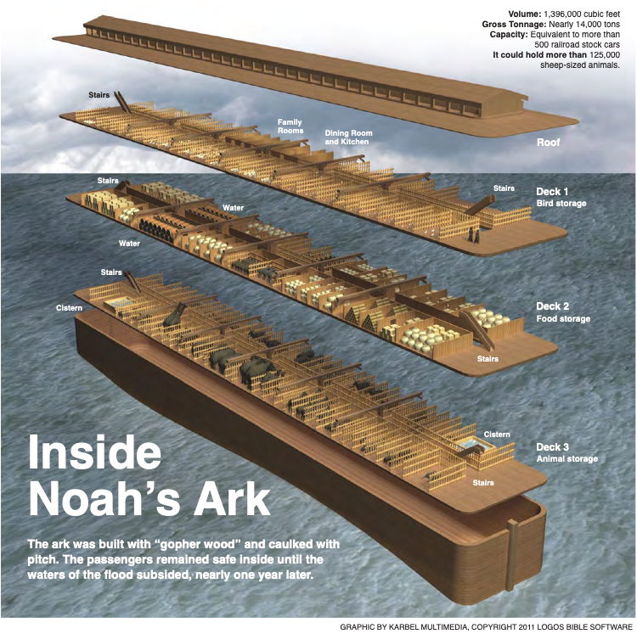
Notes:
In addition, here’s a rendering of how the ark may have been organized on its decks.
And I don’t know about you, but I always thought of the ark as some sort of boat, but there’s no mention of any rudder, or steering, so the ark really functions more as a “chest” – not a ship. A chest used for shelter and the orderly existence of the living creatures inside.
Obviously thinking of the ark as a chest draws a comparison to the Ark of the Covenant. But there’s another usage of the ark (“teba” in Hebrew) in the bible that we know about. Any guesses? The vessel that Moses was put in as a baby is also “teba” or ark in Hebrew. And it served the same purpose – to provide shelter (in water) and ultimately salvation (life) for its inhabitants.
I don’t know about you, but I don’t recall making the connection between the passage of Noah and his family, nor Moses, through water, to their salvation/new life – to baptism. 1 Peter 3:18-22 says exactly this. Now, we know that their passing through the water was not directly for the salvation we know we receive through baptism today, but it reinforces how much ground work is laid in Genesis for the rest of the bible and how people then (and us today) come to understand and obey God.
1 Peter 3:18-22 – For Christ also died for since once for all, the just for the unjust, so that He might bring us to God, having been put to death in the flesh, but made alive in the spirit; in which also He went and made proclamation to the spirits now in prison, who once were disobedient, when the patience of God kept waiting in the days of Noah, during the construction of the ark, in which a few, that is, eight persons, were brought safely through the water. Corresponding to that, baptism now saves you – not the removal of dirt from the flesh, but an appeal to God for a good conscience – through the resurrection of Jesus Christ, who is a the right hand of God, having gone into heaven, after angels and authorities and powers had been subjected to Him.

Slide 11
God’s Covenant with Noah
v18 – “But I will establish My covenant with you; and you shall enter the ark – you and your sons and your wife, and your sons’ wives with you.”
v22 – “Thus Noah did; according to all that God had commanded him, so he did.”
Hebrews 11:7 – “By faith Noah… in reverence prepared an ark for the salvation of his household… and became an heir of the righteousness which is according to faith.”
Notes:
God reveals the details to Noah of the destruction He would bring in verse 17 – “Behold, I, even I am bringing the flood of water upon the earth, to destroy all flesh in which is the breath of life, from under heaven; everything that is on the earth shall perish.”
Continuing in verse 18 – “But I will establish My covenant with you; and you shall enter the ark – you and your sons and your wife, and your sons’ wives with you.” And we know that he was to bring two of every living thing on as well.
This is the first time we see the word “covenant” in the bible. What is a covenant? A binding agreement between two parties. They don’t have to be equal parties, but they bind each other together.
What was God’s part of the covenant? To provide safe passage from the flood, but also from the evil/wickedness of man that was prevalent.
What was Noah’s part of the covenant? To do what the Lord instructed regarding building the ark and in bringing all the living things into the ark. What was Noah’s response to what the Lord told him to do? Verse 22 – “Thus Noah did; according to all that God had commanded him, so he did.”
Noah becomes one of the great examples of faith talked about throughout the bible.
Hebrews 11:6-7 – “And without faith it is impossible to please Him, for he who comes to God must believe that He is and that He is a rewarder of those who seek Him. By faith Noah, being warned by God about things not yet seen, in reverence prepared an ark for the salvation of his household, by which he condemned the world, and became an heir of the righteousness which is according to faith.”
Noah didn’t have any evidence that a flood was coming. In fact, 100 years go by between our introduction to Noah and the initiation of the flood. But he trusted in God and followed His commands.
Noah’s story also sets up something else that becomes a key part of the gospel. That the obedience and righteousness of one can save many. We know Noah was married, and had 3 married sons, but we know nothing of their own faith or character. Noah was the one God chose to make His covenant with, and through Noah’s obedience to God’s instructions, he and his family would be saved.
2 Peter 2:5, speaking of God in that He “Did not spare the ancient world, but preserved Noah, a preacher of righteousness, with seven others, when He brought a flood upon the world of the ungodly.”
And most significantly in the righteousness of Jesus, as highlighted in Romans 5:18-19 – “So then as through one transgression there resulted in condemnation to all men, even so through one act of righteousness there resulted justification of life to all men. For as through the one man’s disobedience the many were made sinners, even so through the obedience of the One the many will be made righteous.”

