Slide 1
CHAPTER 2

Slide 2
GOD’S REST
Genesis 2:1–3 (ESV)
¹ Thus the heavens and the earth were finished, and all the host of them. ² And on the seventh day God finished his work that he had done, and he rested on the seventh day from all his work that he had done. ³ So God blessed the seventh day and made it holy, because on it God rested from all his work that he had done in creation.

Slide 3
MAN AS INTENDED
Necessary (vs. 5)
Provided for (vss. 9,16)
At rest with God (vss. 10-15)

Slide 4
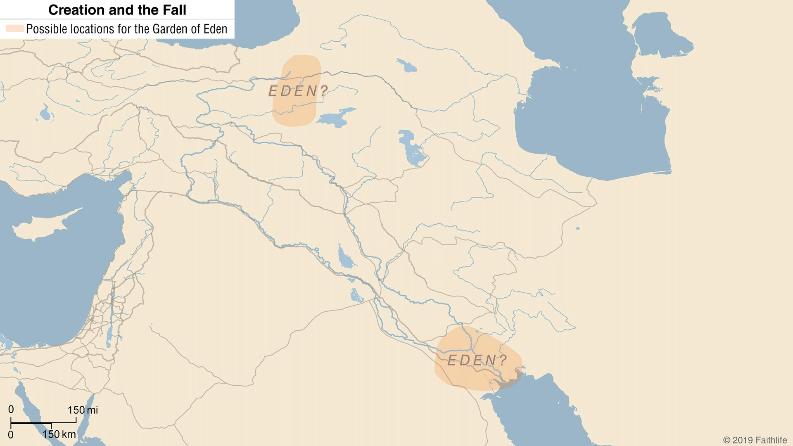
MAN AS INTENDED

Slide 5
MAN AS INTENDED
Necessary (vs. 5)
Provided for (vss. 9,16)
At rest with God (vss. 10-15)
Dominion over creation (vs. 19; 1.28)
Subject to God (vss. 7,16-17)

Slide 6
MAN & WOMAN IN GOD’S IMAGE
Genesis 2:18–20 (ESV)
¹⁸ Then the Lord God said, “It is not good that the man should be alone; I will make him a helper fit for him.” ¹⁹ Now out of the ground the Lord God had formed every beast of the field and every bird of the heavens and brought them to the man to see what he would call them. And whatever the man called every living creature, that was its name. ²⁰ The man gave names to all livestock and to the birds of the heavens and to every beast of the field. But for Adam there was not found a helper fit for him.

Slide 7
MAN & WOMAN IN GOD’S IMAGE
Genesis 2:21–25 (ESV)
²¹ So the Lord God caused a deep sleep to fall upon the man, and while he slept took one of his ribs and closed up its place with flesh. ²² And the rib that the Lord God had taken from the man he made into a woman and brought her to the man. ²³ Then the man said, “This at last is bone of my bones and flesh of my flesh; she shall be called Woman, because she was taken out of Man.” ²⁴ Therefore a man shall leave his father and his mother and hold fast to his wife, and they shall become one flesh. ²⁵ And the man and his wife were both naked and were not ashamed.

