Slide 1
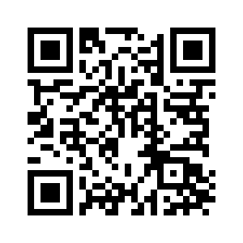
CHAPTERS 10 -11

Slide 2
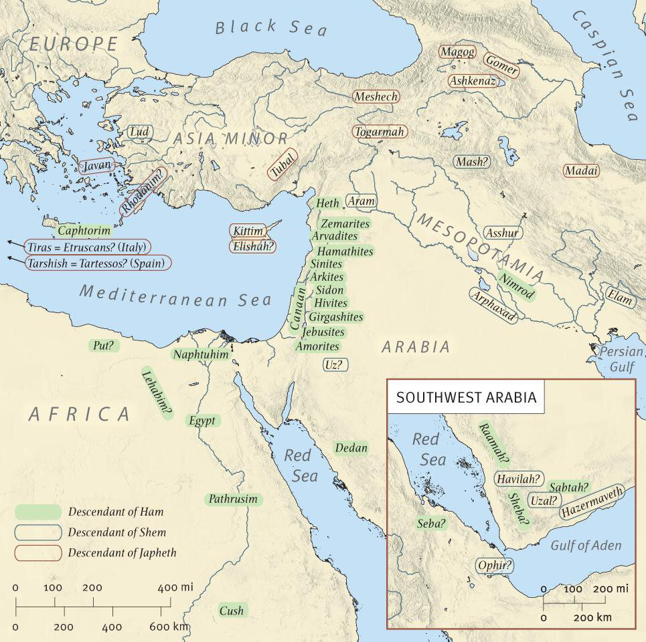

Slide 4
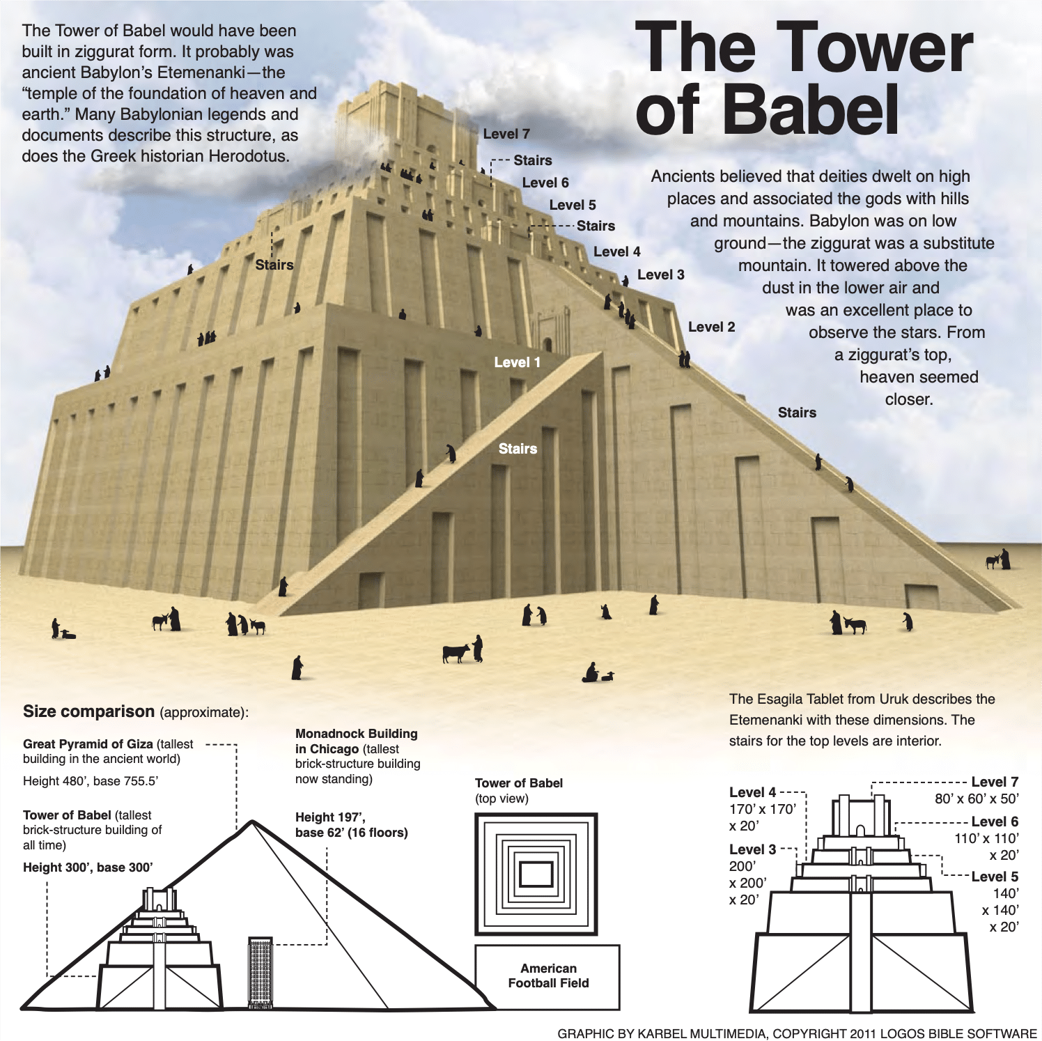

Slide 5
11.1-9, Tower of Babel
They aimed to build a tower and city (vs. 4), but God caused them to abandon the city (vs. 8).
They wished to avoid being scattered (vs. 4), but God scattered the people (vs. 8).
They aimed to build a tower which would reach into the heavens (vs. 4), but it was God who came down in judgment (vss. 5,7).
They wanted to make a name for themselves (vs. 4), the resulting name was Babel (which sounds like the Hebrew word for confusion, vs. 9).
Significantly, in both OT and NT Babylon would represent those opposed to the Lord, but their evil purposes would be defeated (Isaiah 47; Revelation 18).

Slide 6
11.1-9, Tower of Babel
Acts 2:8–11 (ESV)
⁸ And how is it that we hear, each of us in his own native language? ⁹ Parthians and Medes and Elamites and residents of Mesopotamia, Judea and Cappadocia, Pontus and Asia, ¹⁰ Phrygia and Pamphylia, Egypt and the parts of Libya belonging to Cyrene, and visitors from Rome, ¹¹ both Jews and proselytes, Cretans and Arabians—we hear them telling in our own tongues the mighty works of God.”

Slide 7
11.10-26, Descendants of Shem

Slide 8
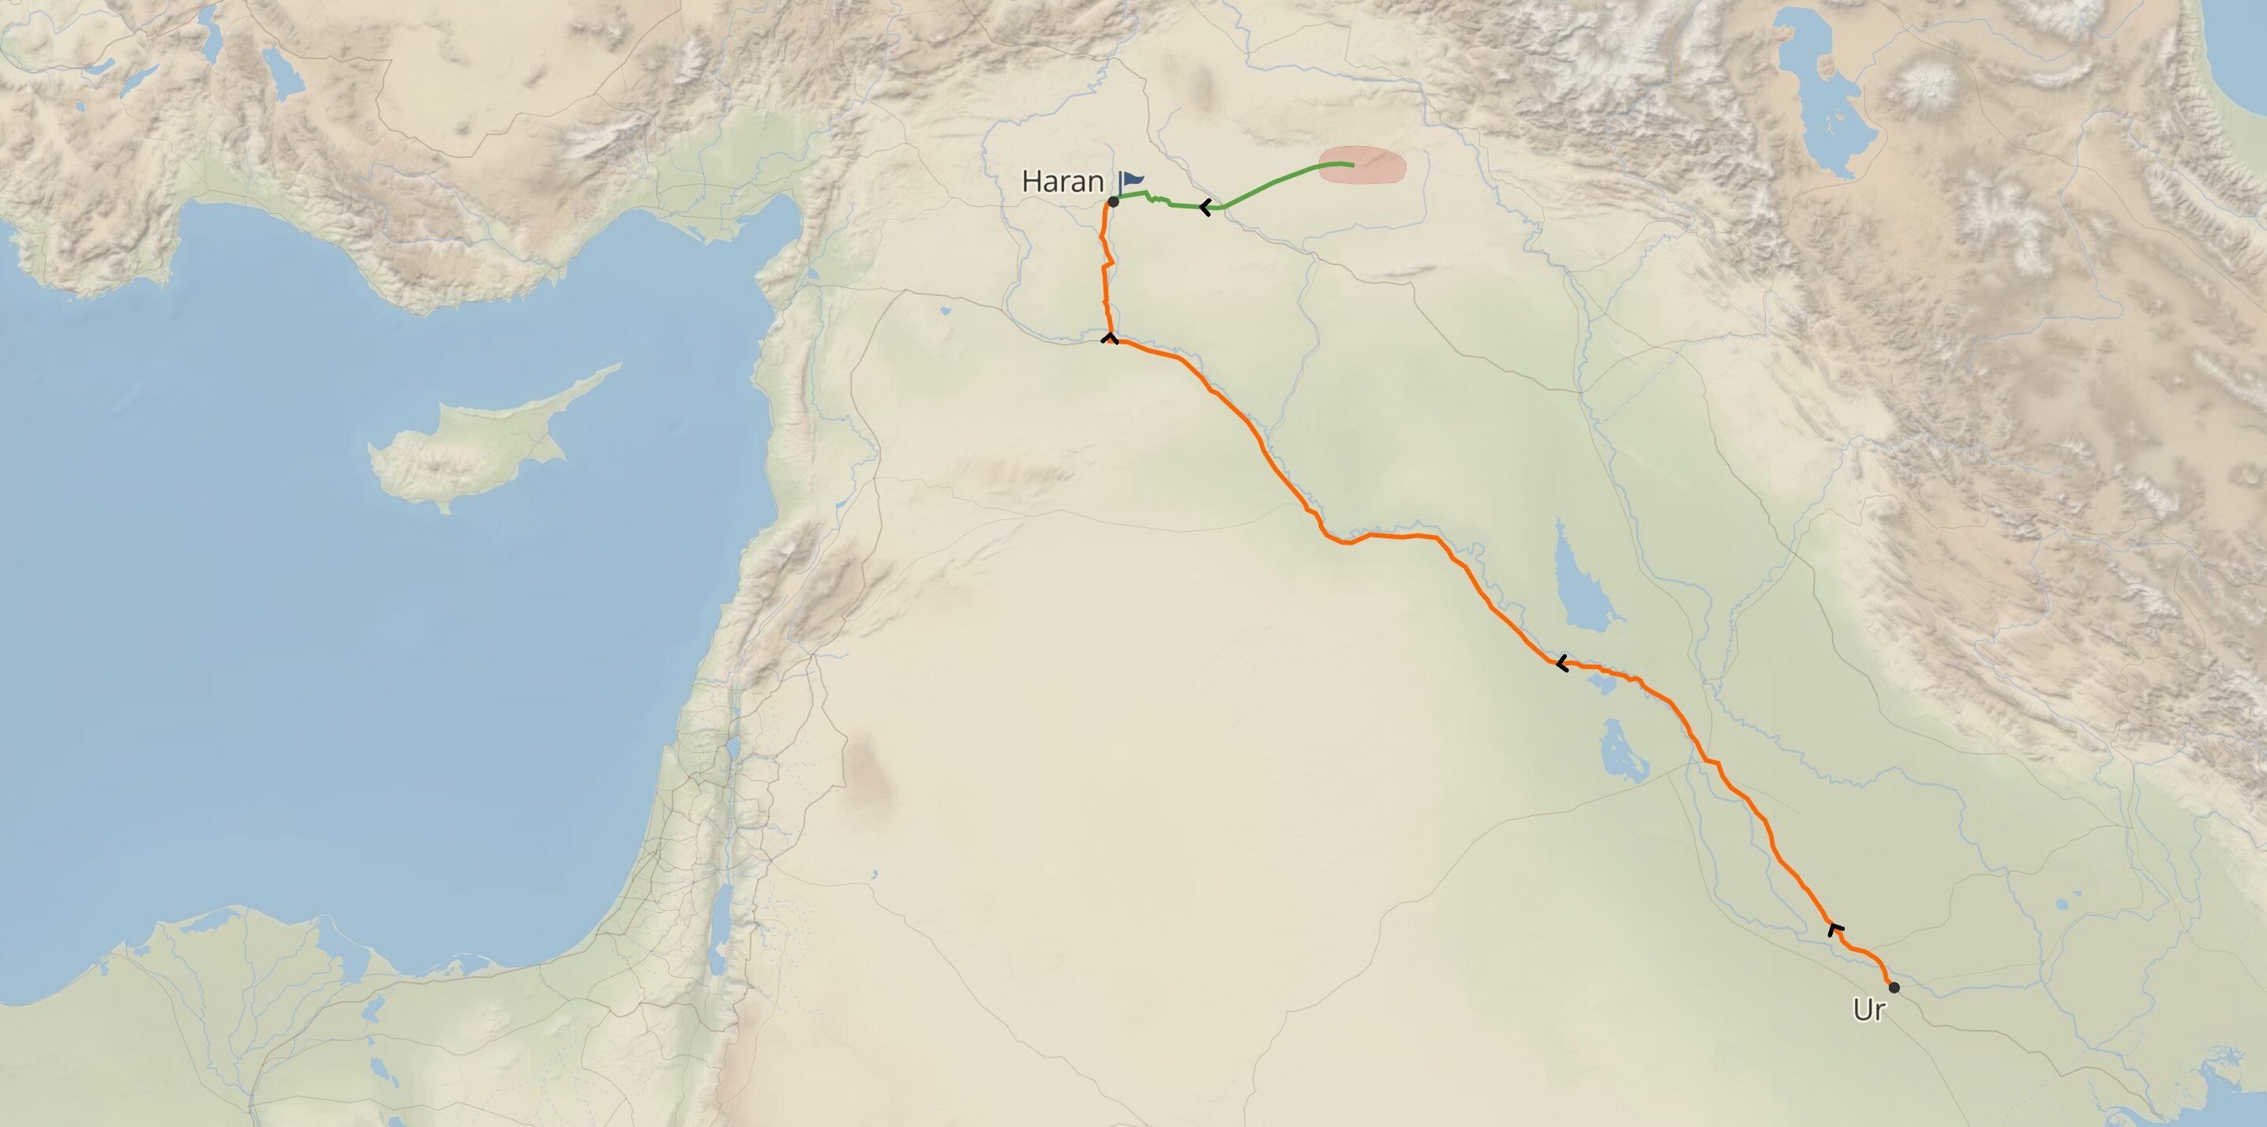
11.27-32, Family of Terah

