Slide 1
THE NECESSITY FOR PRAYER

Slide 2
James 5:13-16
¹³ Is anyone among you suffering? Then he must pray. Is anyone cheerful? He is to sing praises. ¹⁴ Is anyone among you sick? Then he must call for the elders of the church and they are to pray over him, ^{[a]}anointing him with oil in the name of the Lord; ¹⁵ and the prayer of faith will ^{[b]}restore the one who is sick, and the Lord will raise him up, and if he has committed sins, ^{[c]}they will be forgiven him. ¹⁶ Therefore, confess your sins to one another, and pray for one another so that you may be healed. A ^{[d]}prayer of a righteous person, when it is ^{[e]}brought about, can accomplish much.

Slide 3
Prayer Should Be Made On A Daily Basis
1 Thessalonians 5:17 pray without ceasing;
Pray when times are good and when they are bad

Slide 4
Prayer Challenges Us To Be Better
It is man’s instinct to protect themselves and, in this situation, people wouldn’t have been as open about their prayer life…
This was completely left in God’s hands (V.17)
It pushes you of your comfort zone

Slide 5
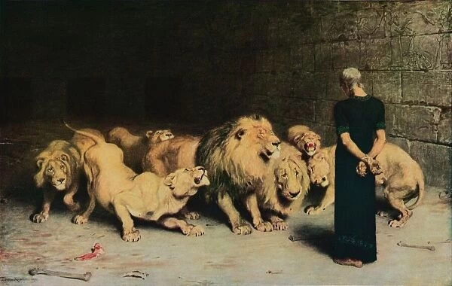

Slide 6
Prayer Can Put The Odds In Your Favor
If God is for you who can be against you?
1 Peter 3:12 "For the eyes of the Lord are toward the righteous, And His ears attend to their prayer, But the face of the Lord is against those who do evil."

Slide 7
Privileges Of Prayer
It Changes You
It Isn’t Limited To Just 1 Place (Jonah 2:1).
Prayers Don’t Have To Be Long (Nehemiah 2:4).
It Gives You Peace (Philippians 4:6-7).

Slide 8
Why does God not answer my prayers?
God won’t answer a man who is living in sin or refuses Him (Proverbs 28:9).
God won’t answer the Christian who is living in sin (Psalm 66:18).
God won’t answer a prayer said with wrong motives (James 4:3).

Slide 9
THE NECESSITY OF PRAYER

